Slide 1
Glimpses of CO-CURRICULAR ACTIVITIES
(2021-2022)

Slide 2
Activities under ‘vision 75 stars’
In pursuance of the notifications issued by the Ministry of Education & HQ Southern Command, the HQ MG&G Area took a great initiative to celebrate & commemorate 75 years of freedom of progressive India & the glorious history of its people, culture and achievements. To mark this unforgettable occasion, APS Mumbai conducted a wide array of activities with the endeavour to reflect the spirit of freedom struggle and to inculcate the feeling of patriotism & commitment towards our Motherland 'India'

Slide 3
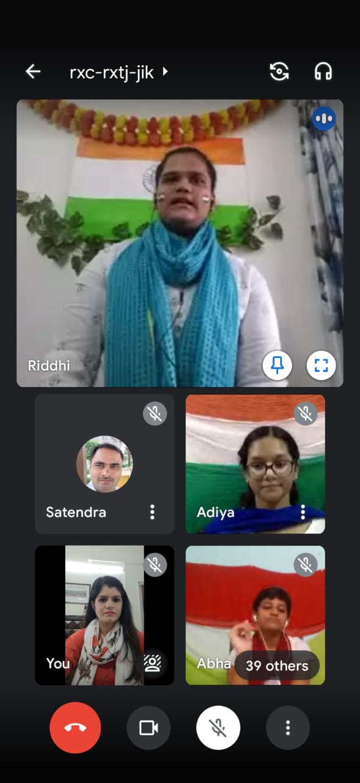
Patriotic song competition Awareness program Quiz competition

Slide 4
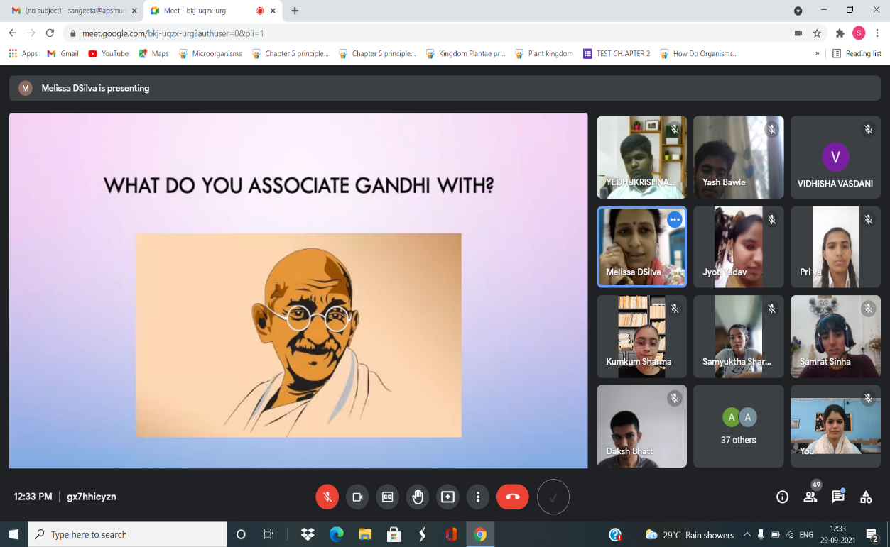
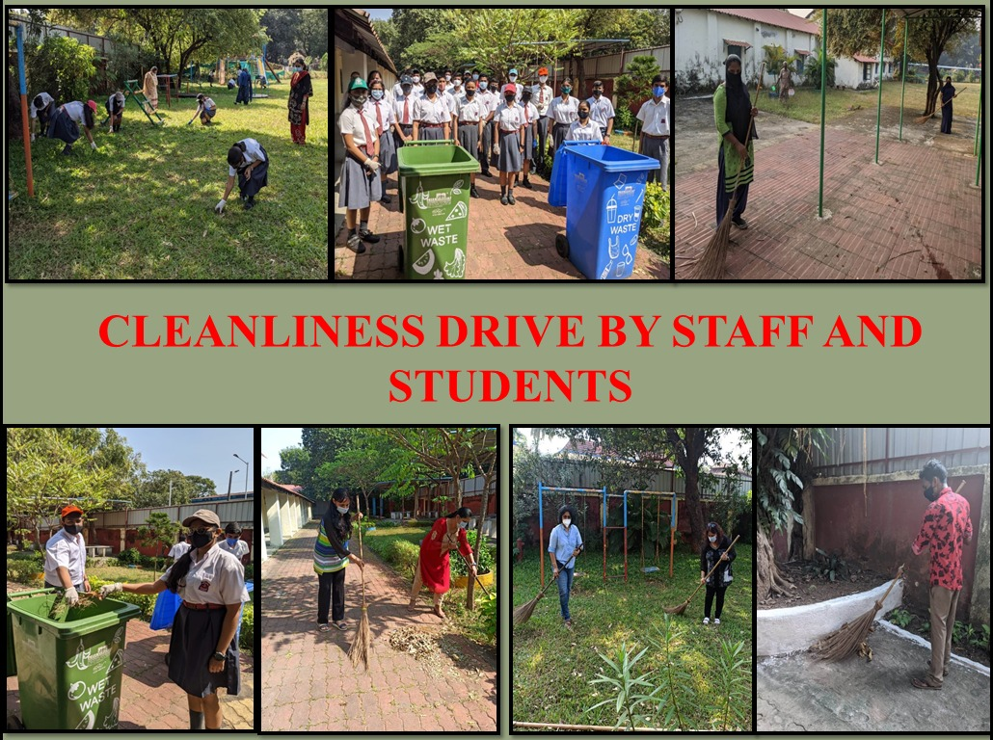
PRESENTATION ON TEACHINGS RASTRIYA EKTA DIWAS cleanliness drive: swachata MAHATMA GANDHI drawing/ painting competition abhiyan

Slide 5
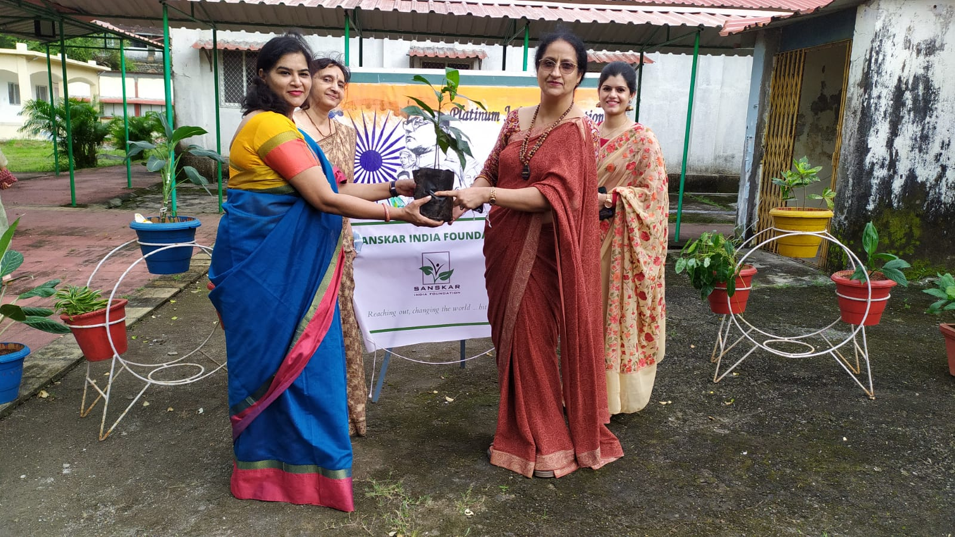
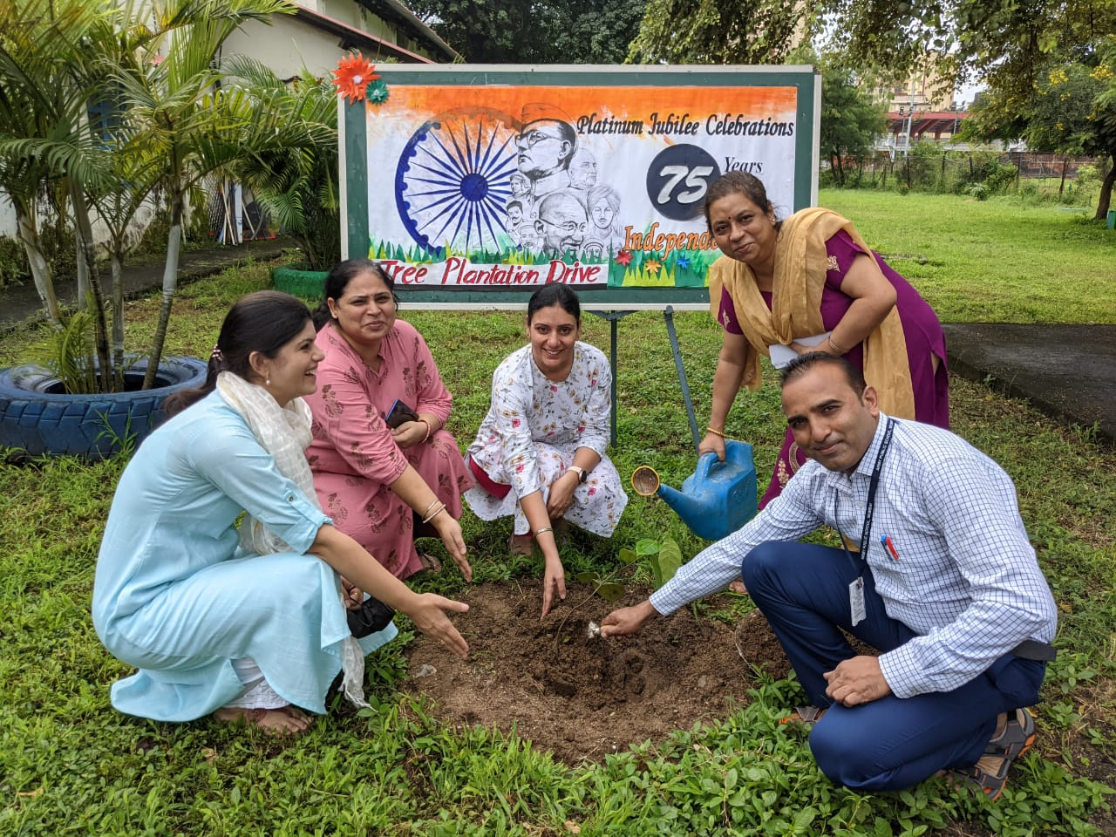
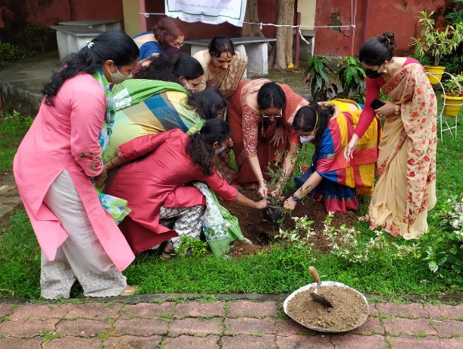
Tree plantation drive
saplings donated by sanskar india foundaton

Slide 6
IN-HOUSE ACTIVITIES

Slide 7
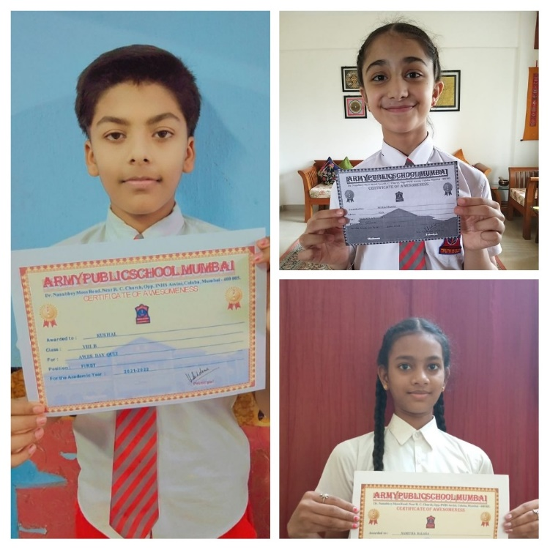
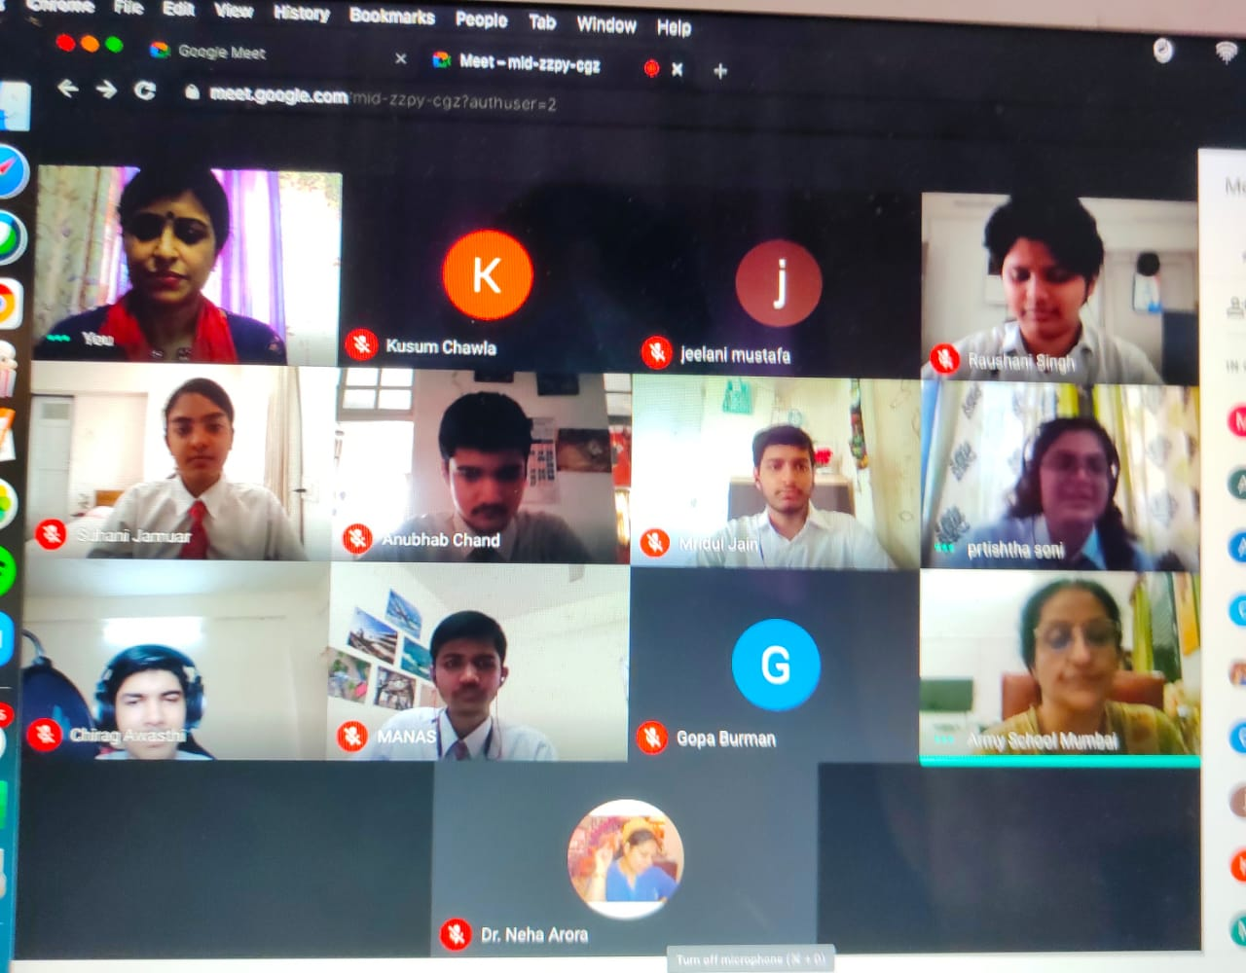
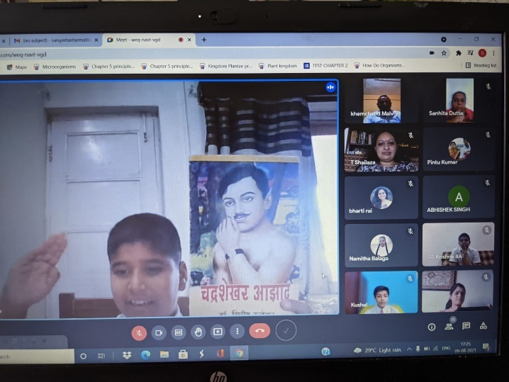
AWES QUIZ COMPETITION Panel discussion on the topic
‘is our present education system
preparing students for the real world’
ESSAY WRITING COMPETITION ON
TOPIC- ‘THE TRUE MEANING OF Hindi Book review on national
FREEDOM IN MODERN SOCIETY’ leaders and freedom fighters

Slide 8
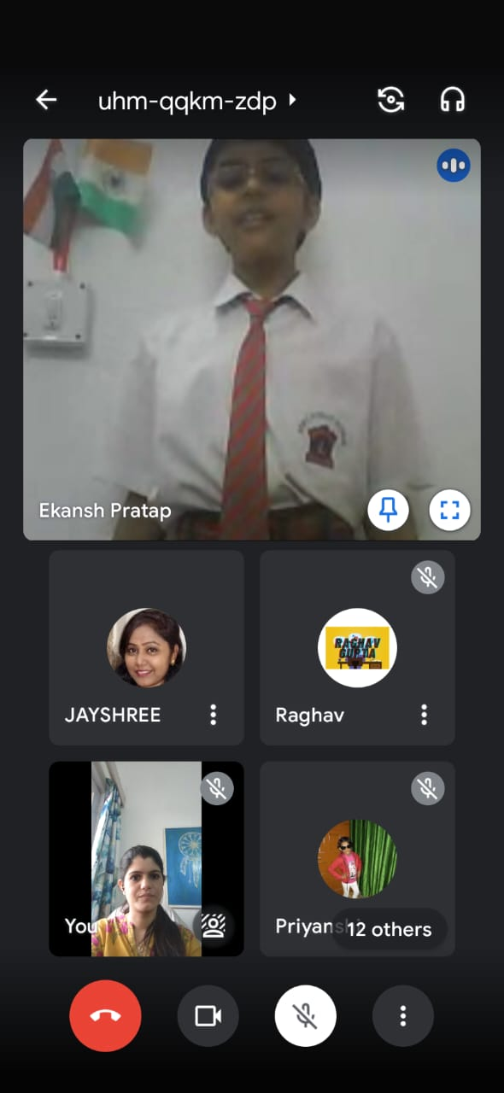
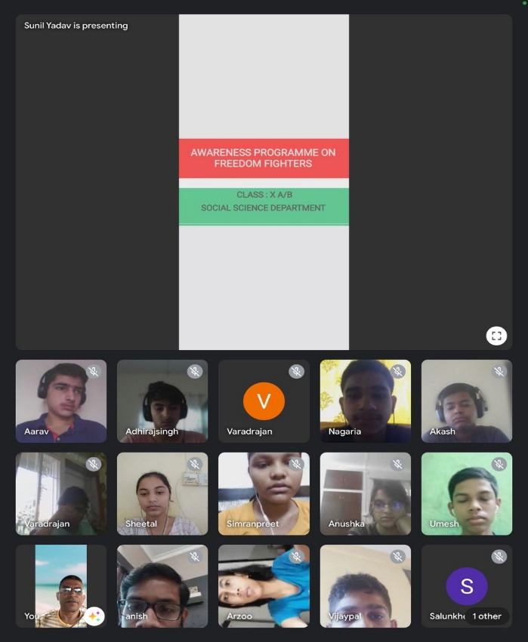
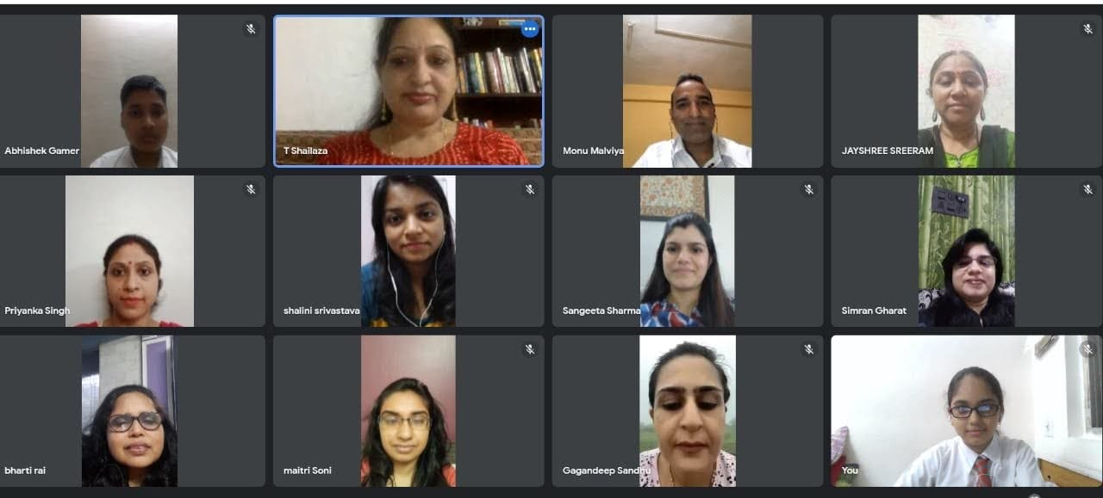
hindi desh bhakti Hindi Diwas Awareness program
Kavita competition virtual meeting 75 freedom fighters/
National leaders

Slide 9
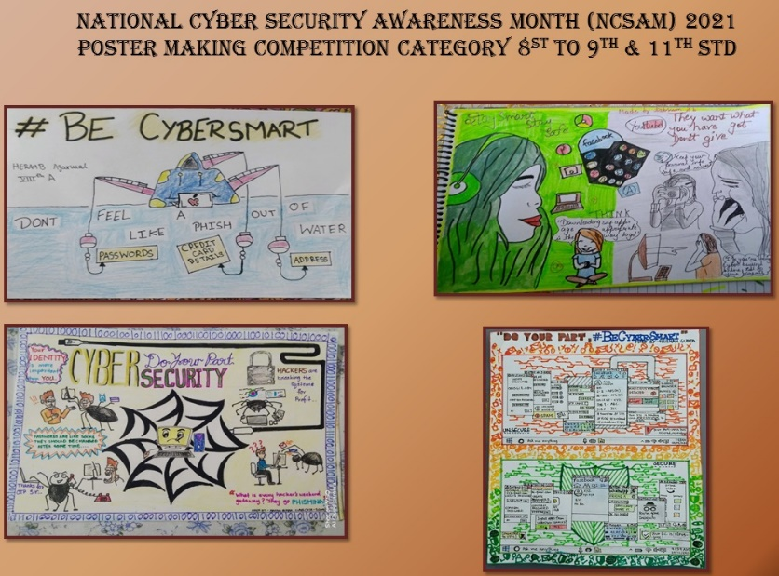
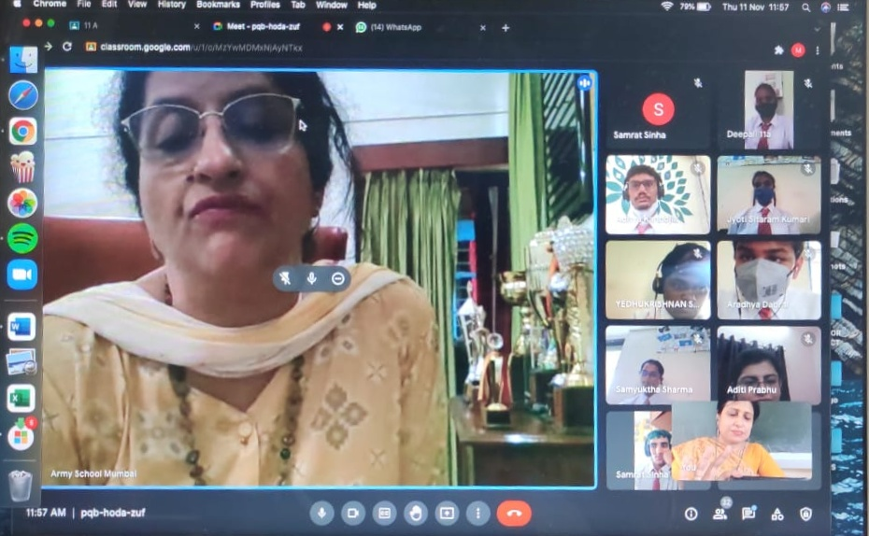
national cyber security awareness creative writing competition on
month drawing/ painting competition the topic ‘ if pandit nehru were to
visit india today

Slide 10
achievers

Slide 11
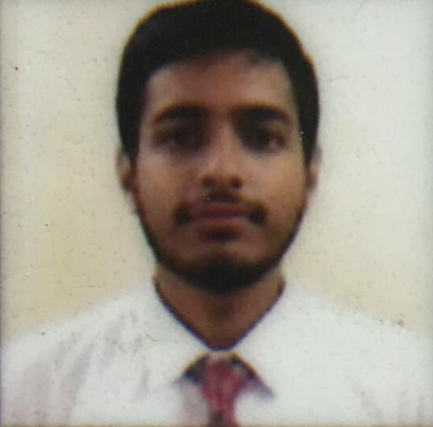
58th edition of India’s International Movement to Unite Nations (IIMUN)
In the global 58th edition of IIMUN Conference, organised by IIMUN organisation more than 500 students across 160 cities and 22 countries took part, where students had to represent various delegates from different countries or communities.
Kushal-VIII
Best Delegate
Continuous Crisis Committee
Mridul Jain-XII
High commendation
LGBTQ+ COMMITTEE

Slide 12
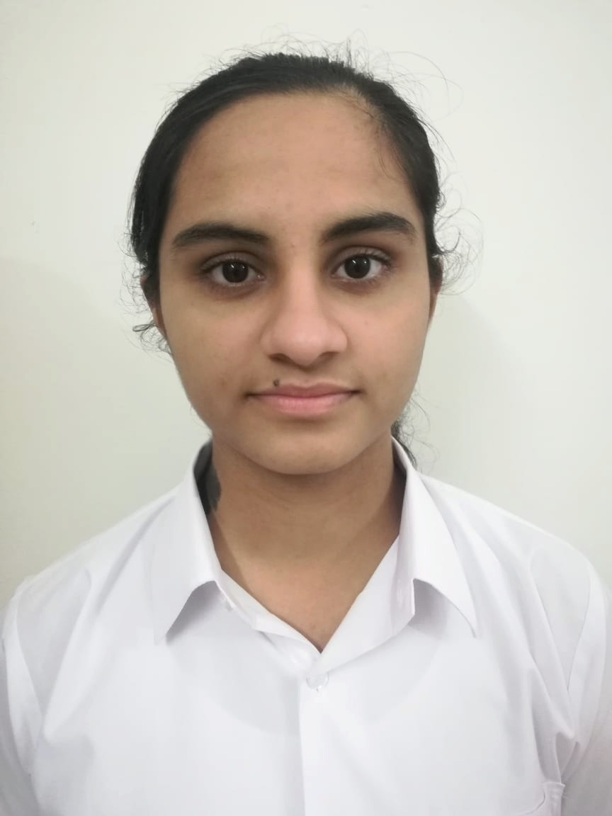
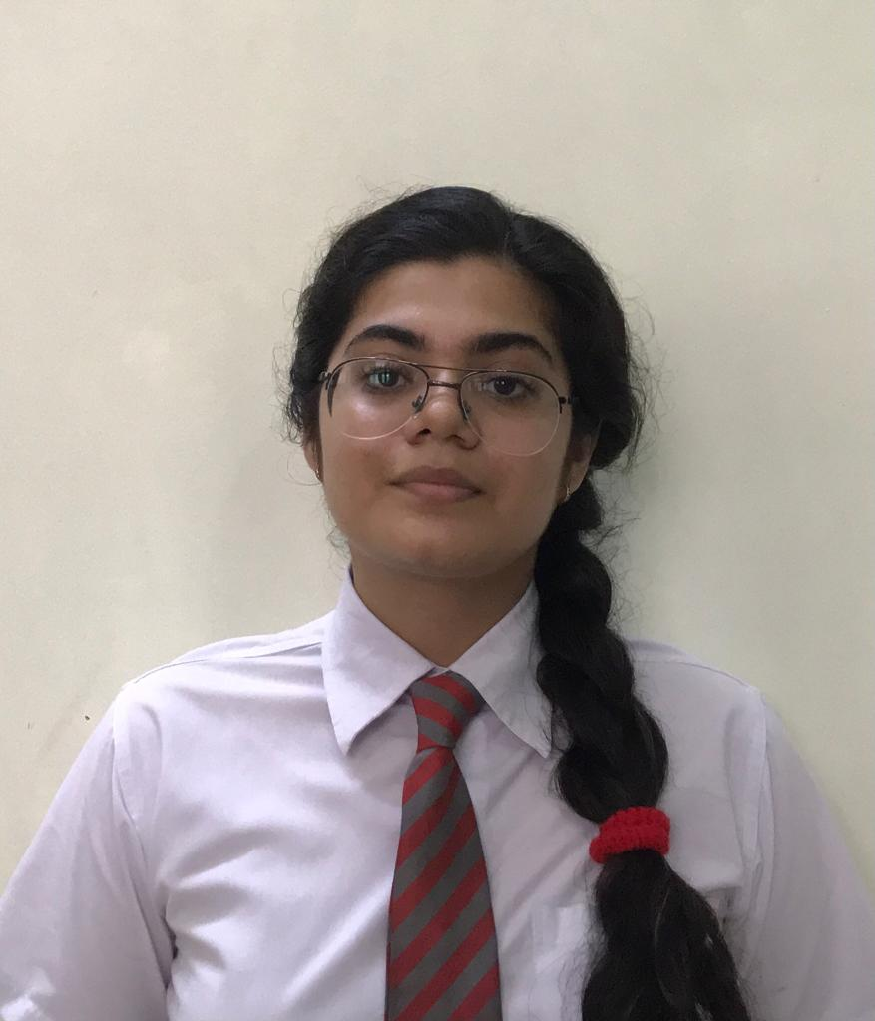
Potenzia Exzeloncse
Potenzia Exzeloncse is a literary and cultural fest conducted by Army Public School RK Puram Secunderabad this event was conducted virtually and Army public schools from all over the country along with few renowned Public Schools participated in the said event.
Students of APS Mumbai participated in seven events, and won prizes in the following events:
1ST PRIZE- ‘Soliloquy’
SABRINA HEHAR- XII
2nd prize-‘Musique de folk’
Dhruv Thapa- iii
2nd prize- ‘Elocution’
Prtishtha soni- xii

Slide 13
the virtual ‘AWES Southern Command Cluster level Hindi debate competition’ hosted by APS Kirkee
The students of Army public school Mumbai had taken part in the virtual ‘AWES Southern Command Cluster level Hindi debate competition’ on the topic ‘ safalta ki sidhiyan chadhta manav paryavaran ko nuksan pahochata gaya
Mannveer Kadian- X A
1st position as Best Speaker ( Against the Motion)

Slide 14
Vigilance Awareness Week Inter-School (VAW) Competitions Organised by Bharat Petroleum Corporation Limited
Following Interschool Competitions on the THEME: INDEPENDENT INDIA @75 SELF RELIENCE WITH INTEGRITY, were organized:
Elocution (English) Junior and senior
Elocution (Hindi) Junior and senior
Poetry (English) Junior and senior
Poetry (Hindi) Junior and senior
Essay (English) Junior and senior
Essay (Hindi) Junior and senior
Slogan (English) Junior and senior
Slogan (Hindi) Junior and senior
Drawing/Painting Junior and senior

Slide 15
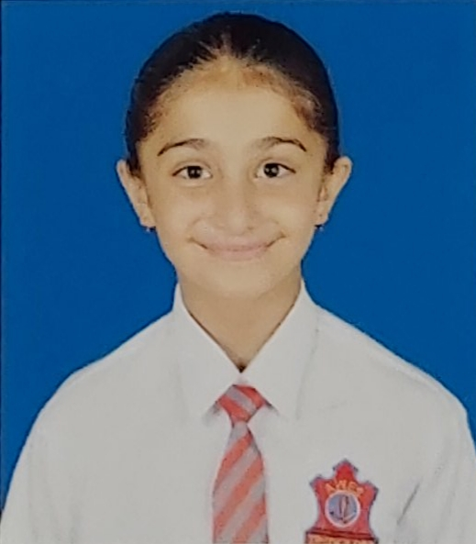
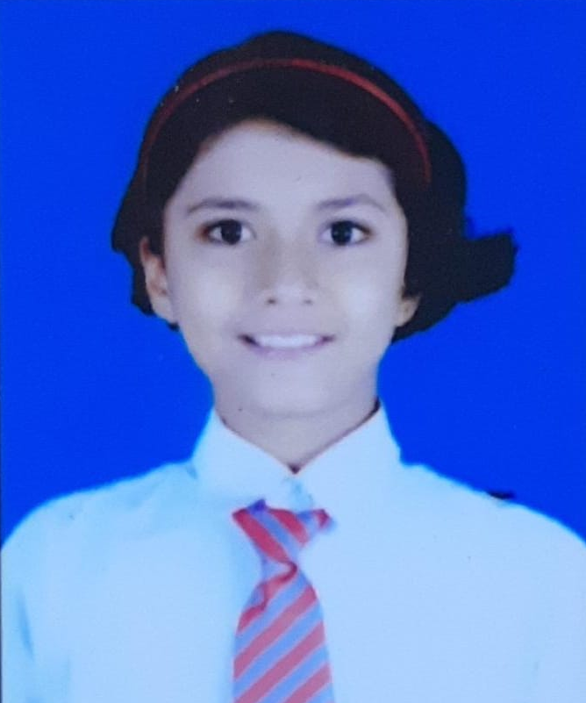
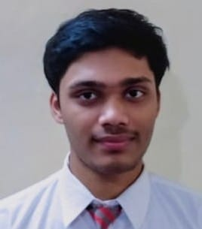
Winners of VAW
Following student’s essay/poem are selected to be printed in BPCL in-house company’s magazine
Sl. No. | Competition | Name of winners
1 | Elocution (English) - Junior | PARTH BHARADWAJ- 7 A
2 | Elocution (English) - Senior | BHOOMI ARORA- 11 A
3 | Elocution (Hindi) - Junior | RAGHAV GUPTA- 6A
4 | Elocution (Hindi) - Senior | MANNVEER KADIAN- 10A
5 | Poetry (English) - Senior | MOHD. SAMI- 12A
6 | Poetry (Hindi) - Junior | PRAGYA SINGH-7B
7 | Poetry (Hindi) - Senior | MANSI JAGTAP-9B
8 | Essay (English) - Junior | SEHAJ BAINS-6A
9 | Essay (English) - Senior | MOKSHA PANDEY-10A
10 | Essay (Hindi) - Junior | RENAISSANCE DUTTA-7A
11 | Slogan (English) - Senior | ARZOO MONDAL-10B
12 | Slogan (Hindi) - Senior | DIKSHA CHAUDHARY-8A
13 | Drawing - Painting - Junior | JUMANA NASREEN-6B
14 | Drawing - Painting - Junior | ANANTIKA MISAL-6B
15 | Drawing - Painting - Senior | DIVYANSHU SINGH TALUKI-8A
16 | Drawing - Painting - Senior | ARYENDRA SINGH PARIHAR-10A
SEHAJ BAINS- Essay (English) - Junior
REINAISSANCE DUTTA-Essay (Hindi) - Junior
MD. SAMI-Poetry (English) - Senior

Slide 16
EDUCATIONAL VISITS

Slide 17
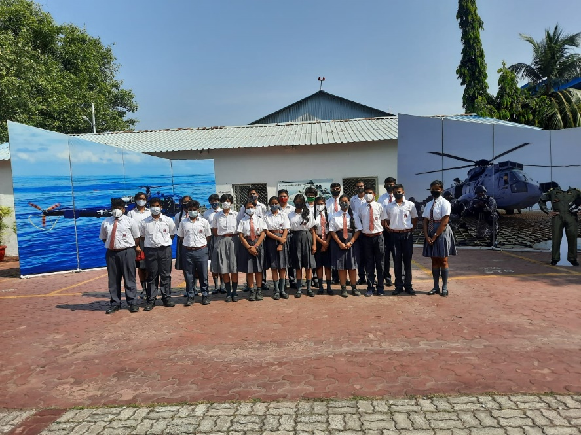
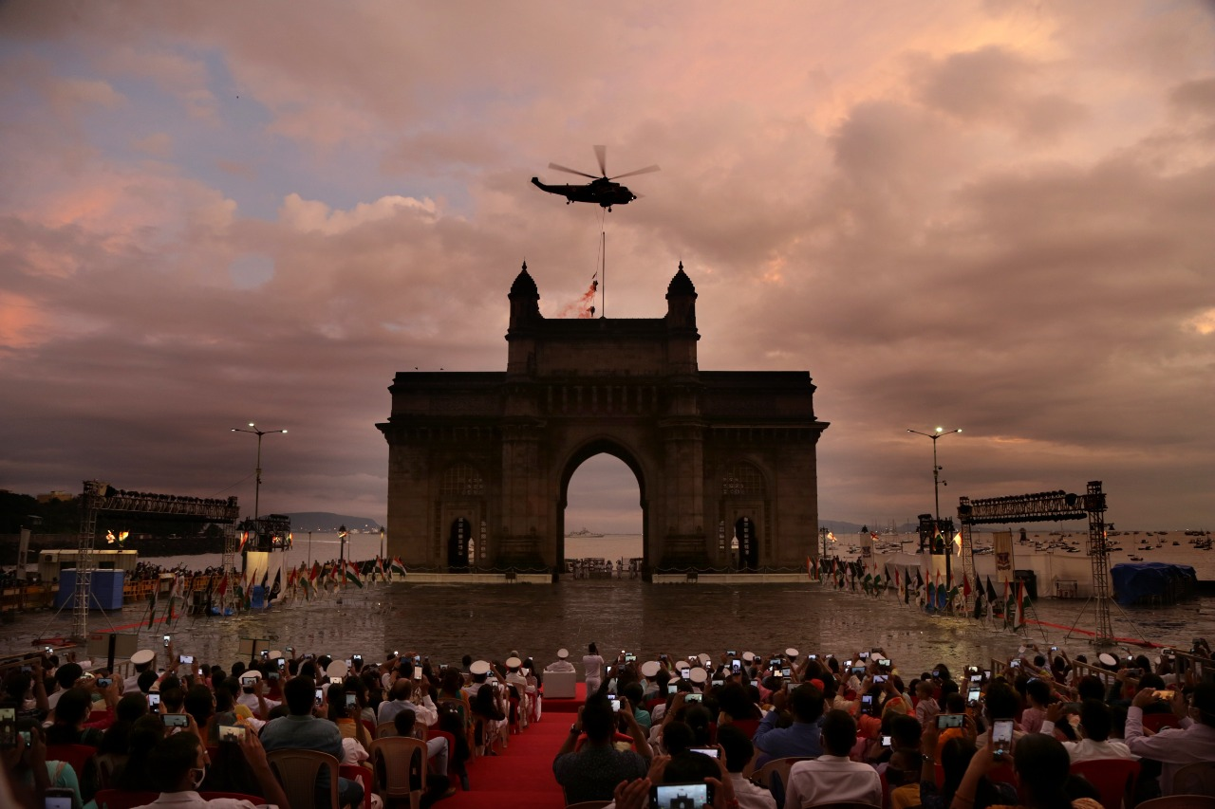
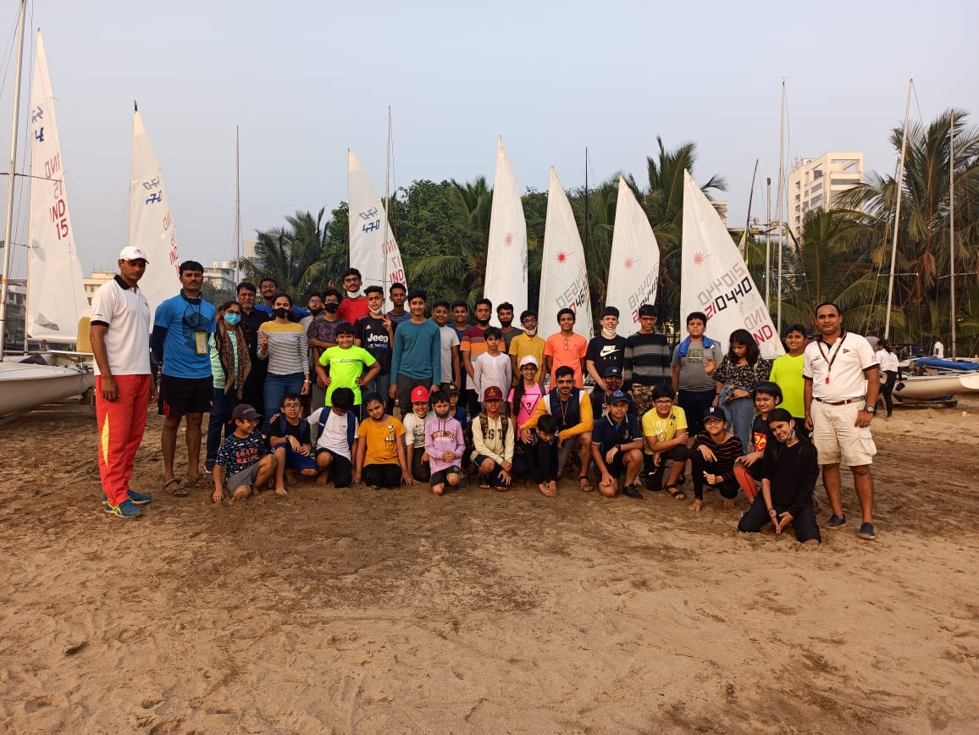
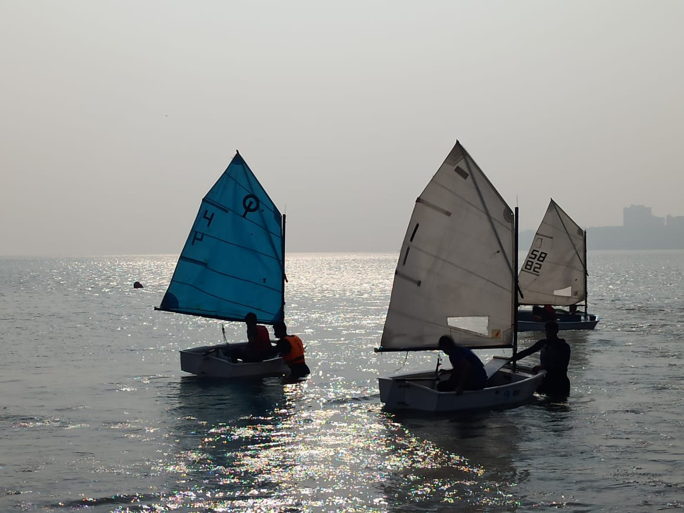
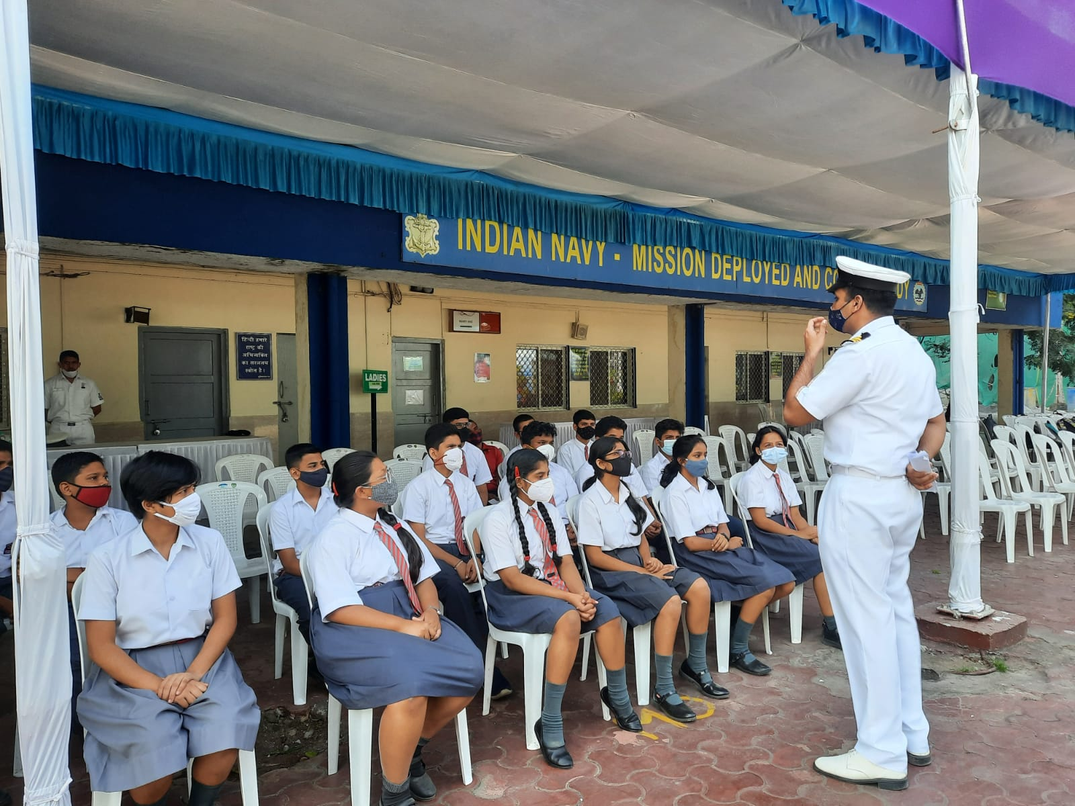
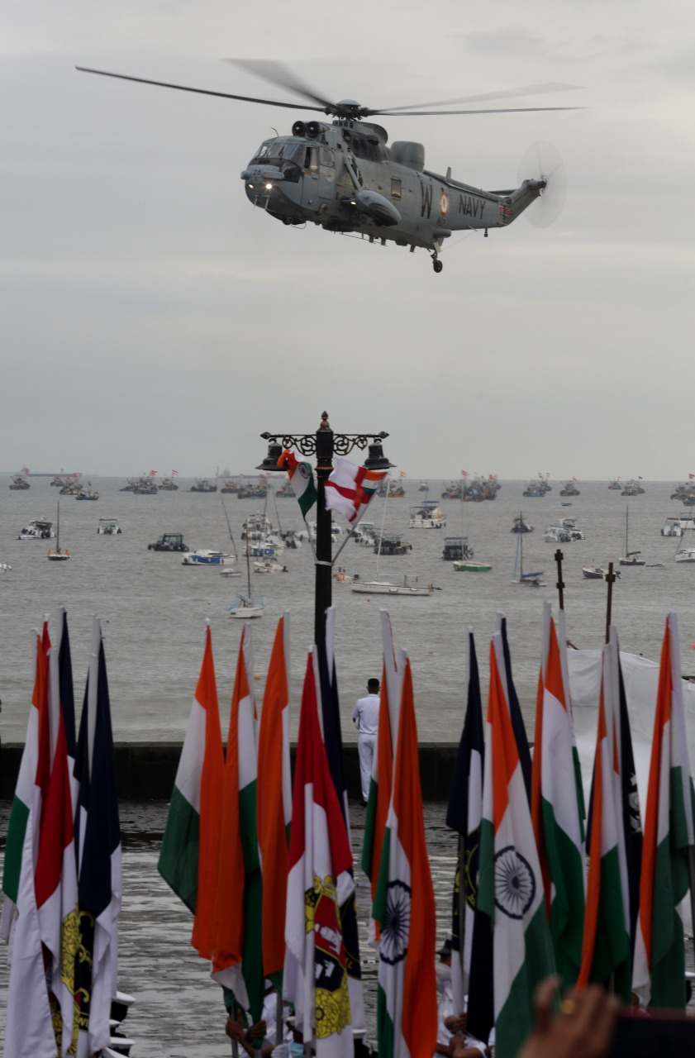
INS SHIKRA: Demonstration and BEATING the RETREAT AT SAILING CAMP BY Display of Naval Helicopters GATEWAY OF INDIA ARMY YACHtING NODE

Slide 18
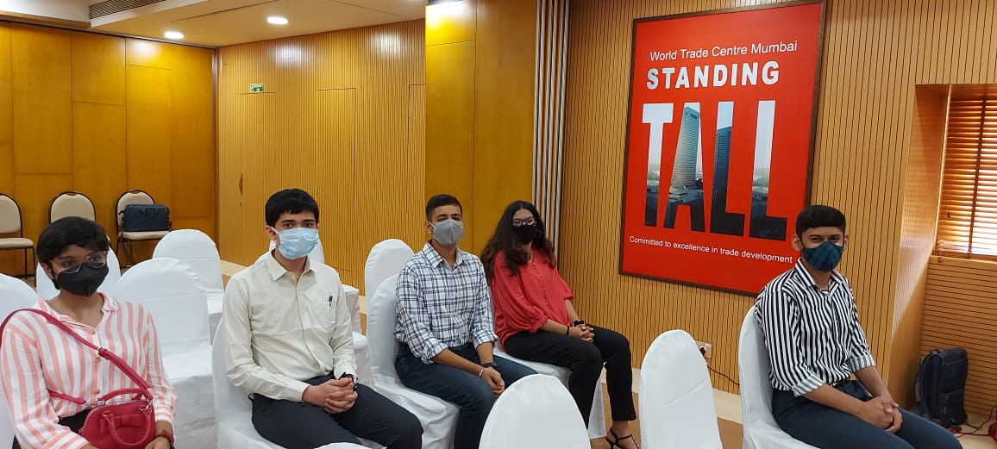
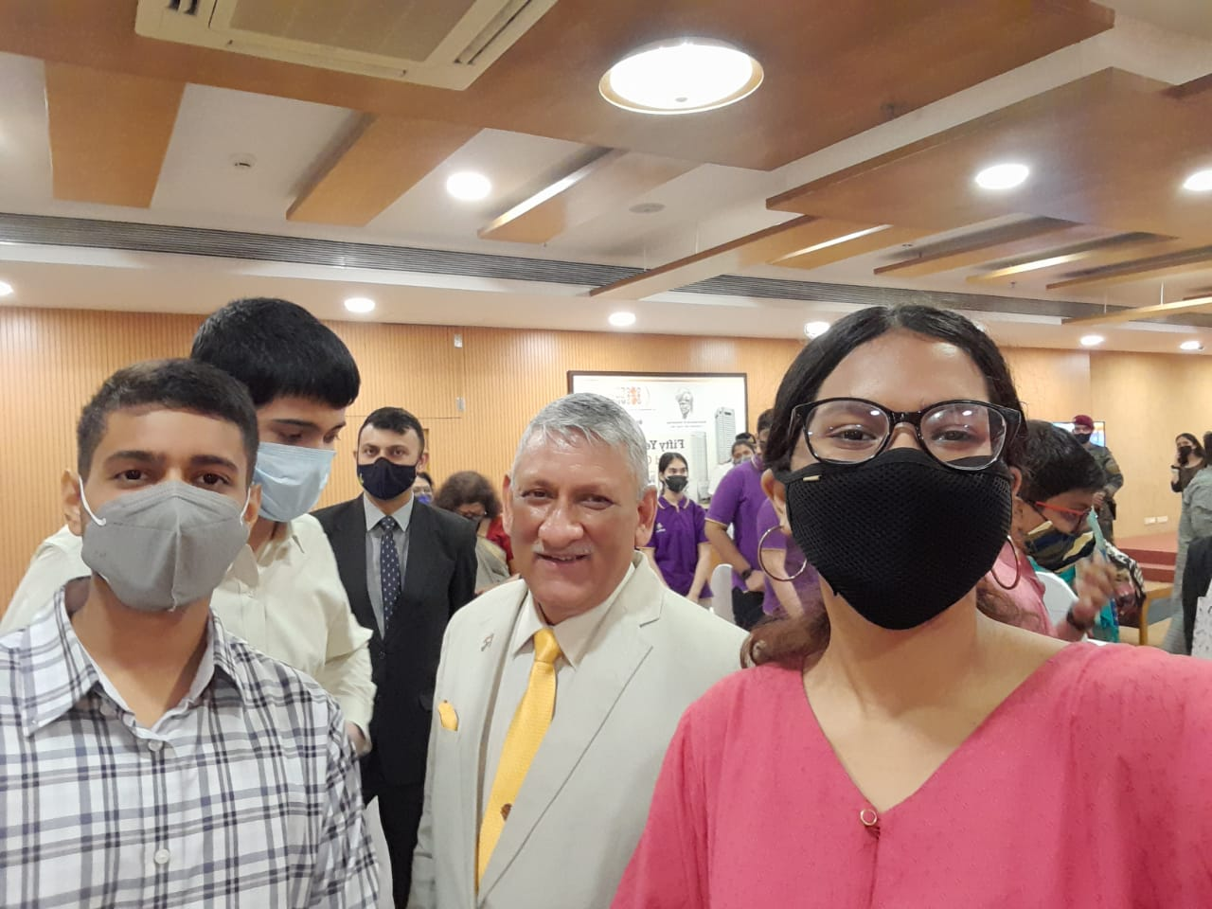
Children's Day celebration India’s international movement of united nation(IIMUN) Late Gen. Bipin Rawat interacting with school students on the occasion of children’s day

Slide 19
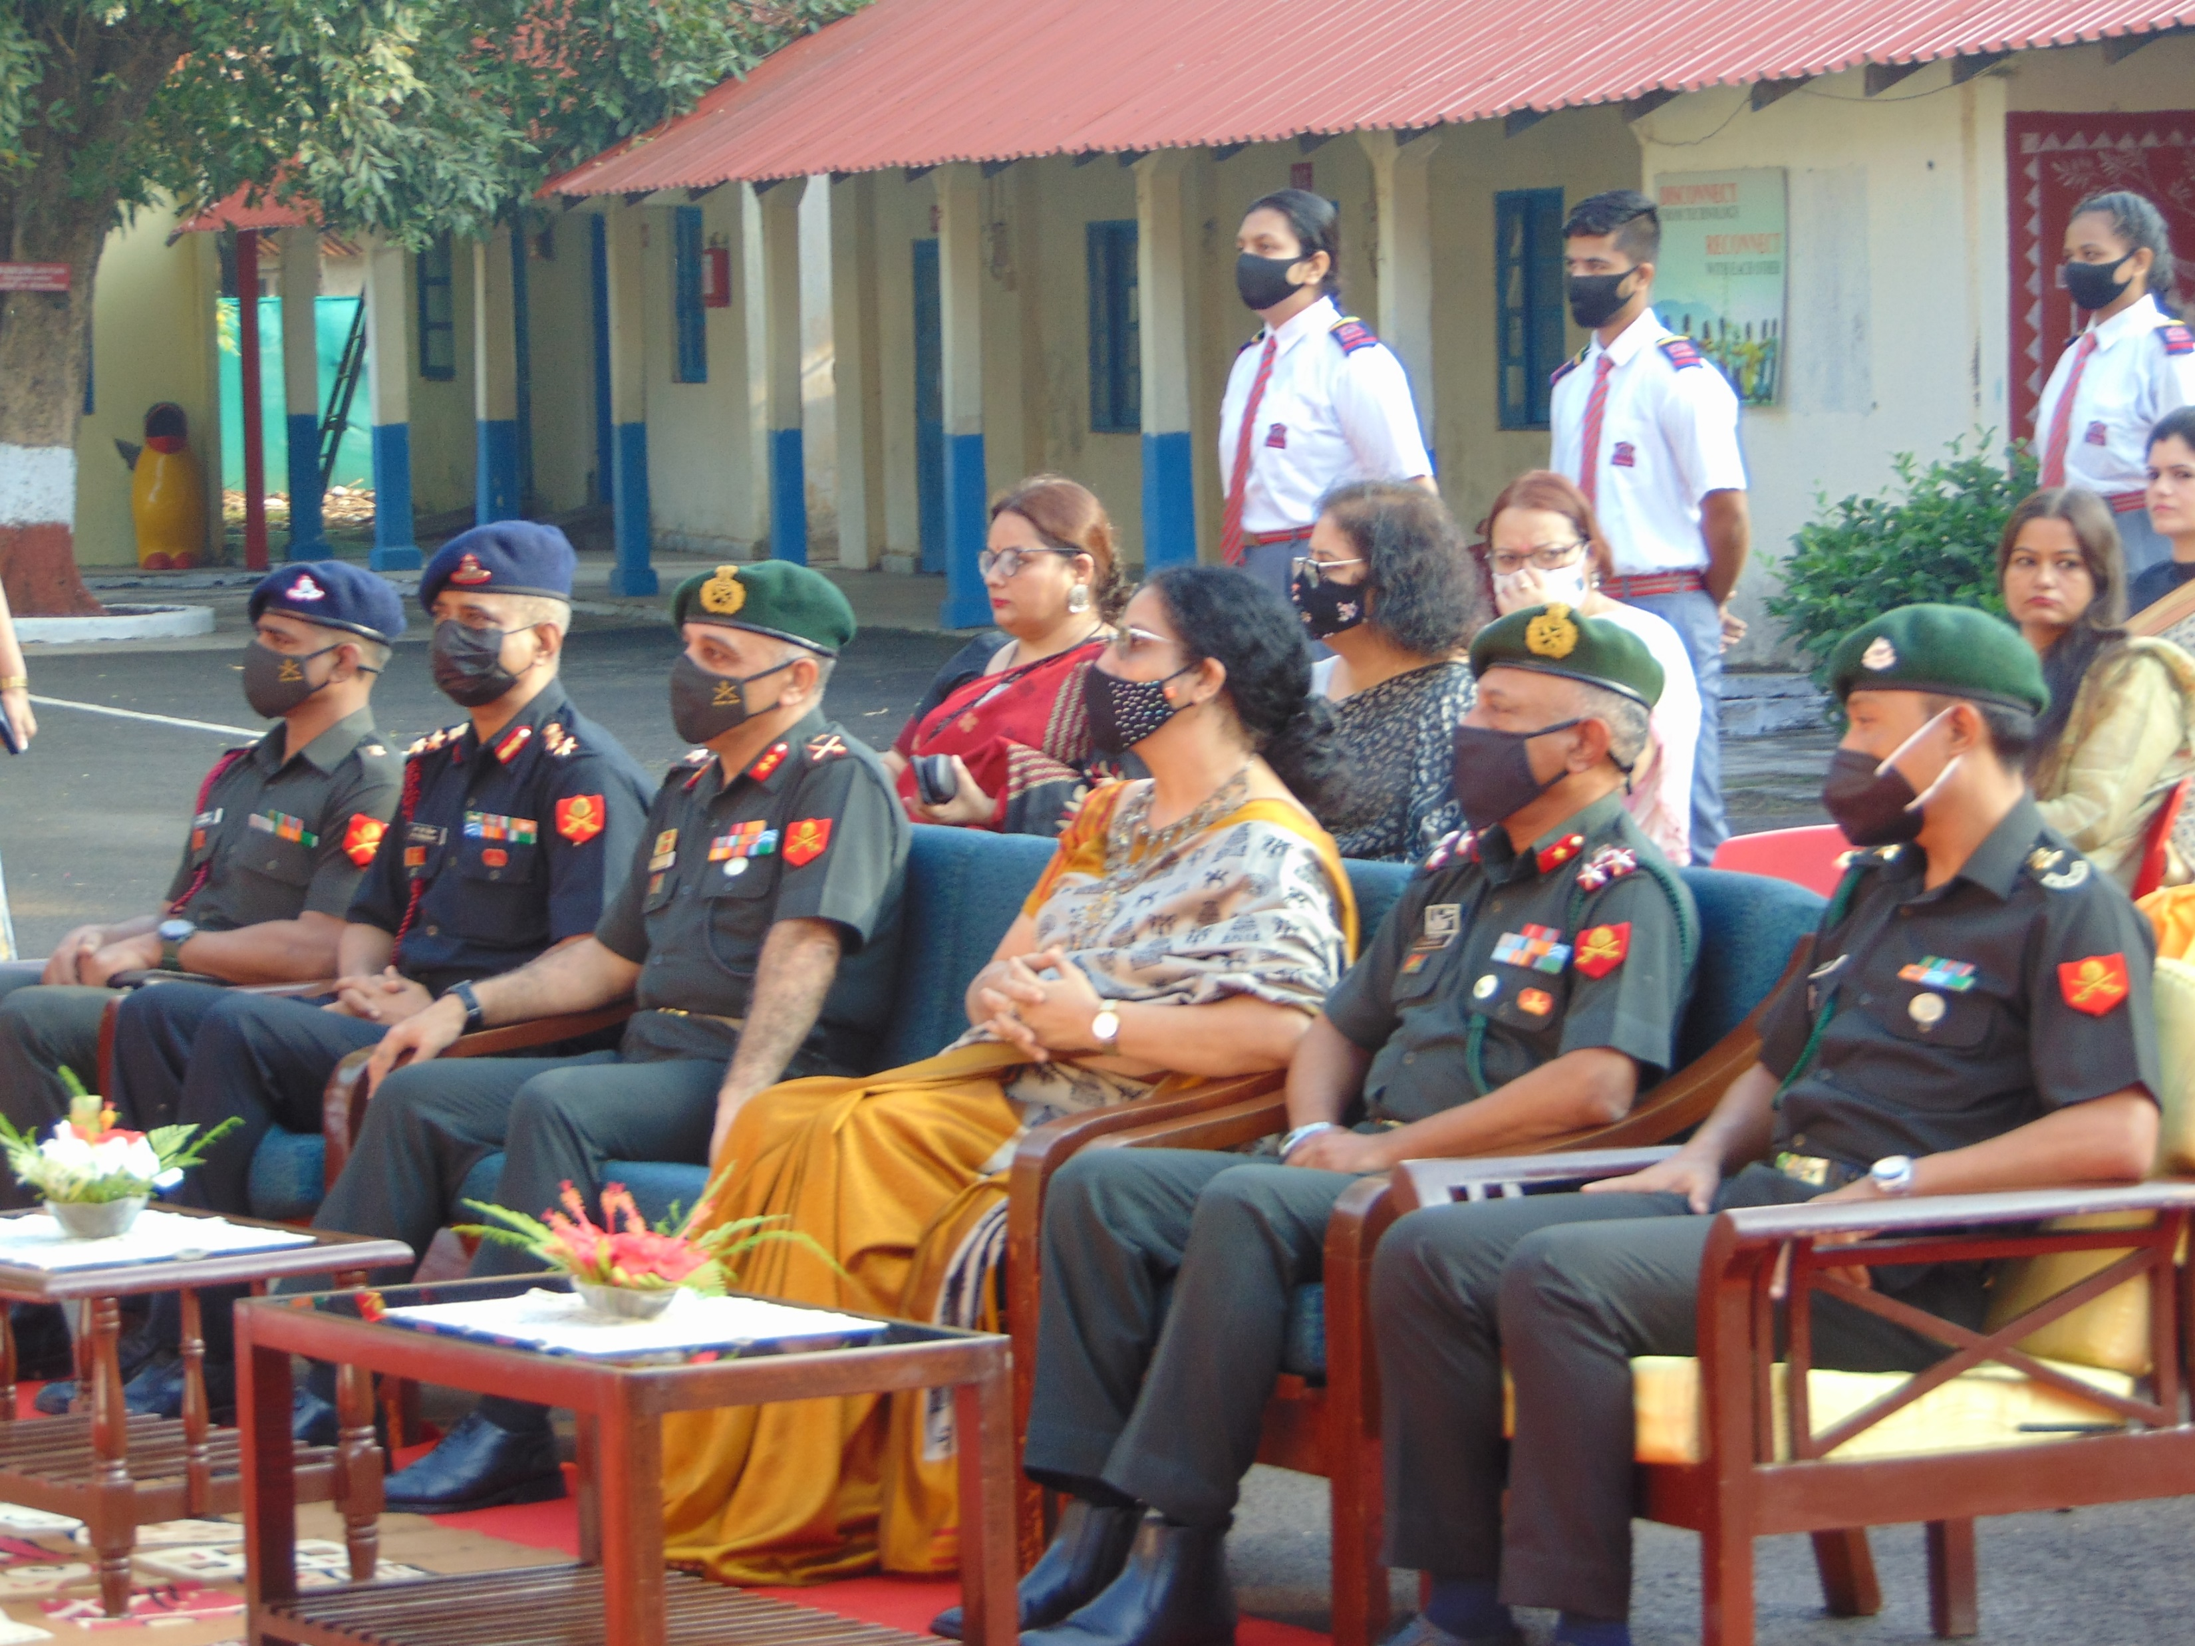
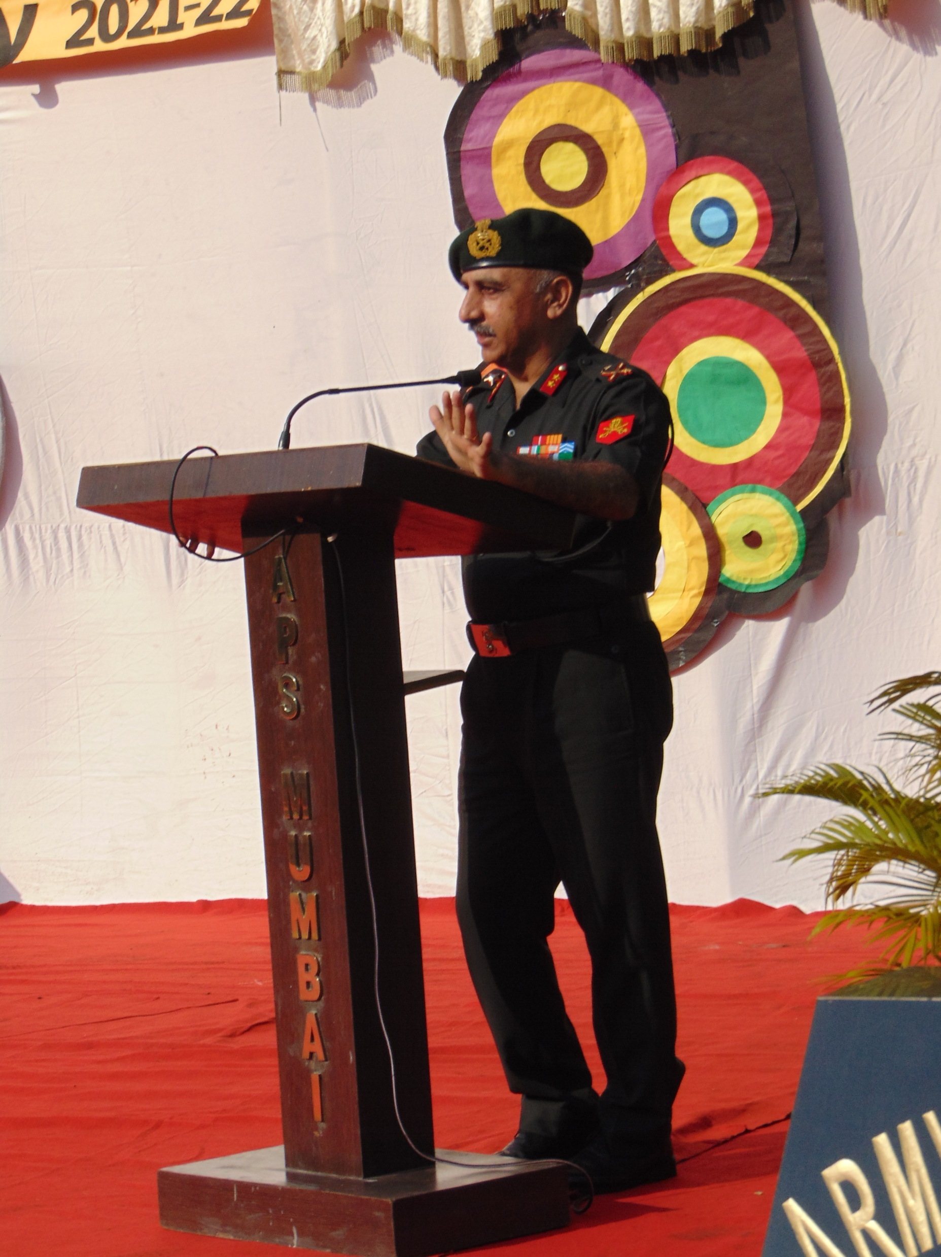
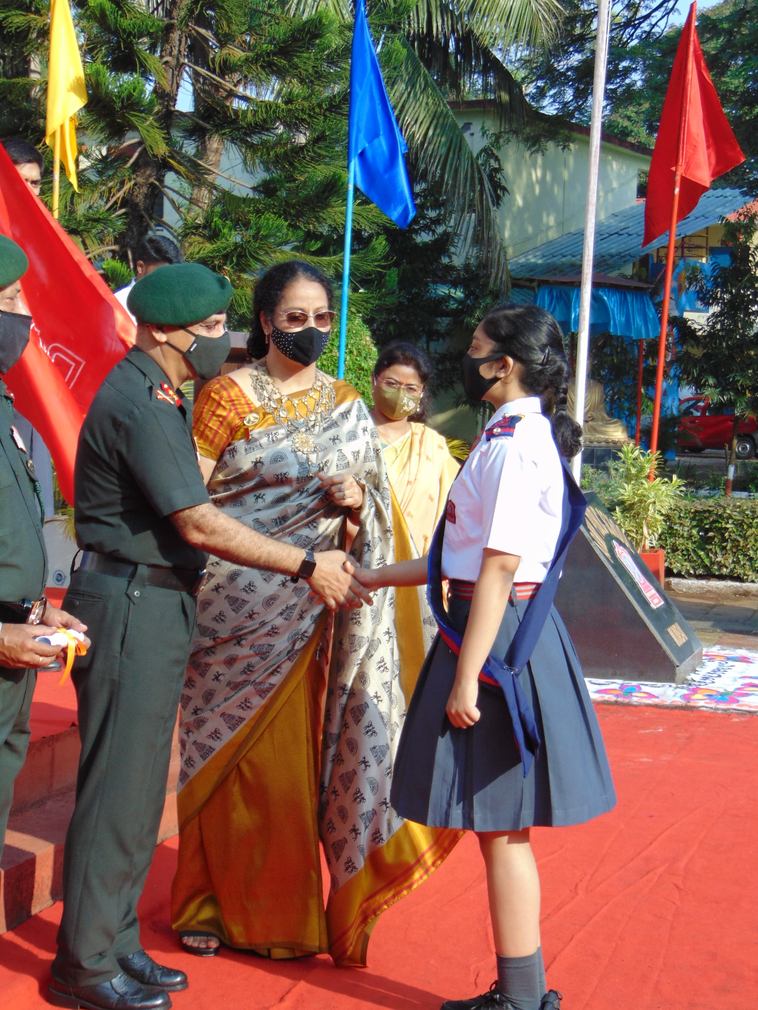
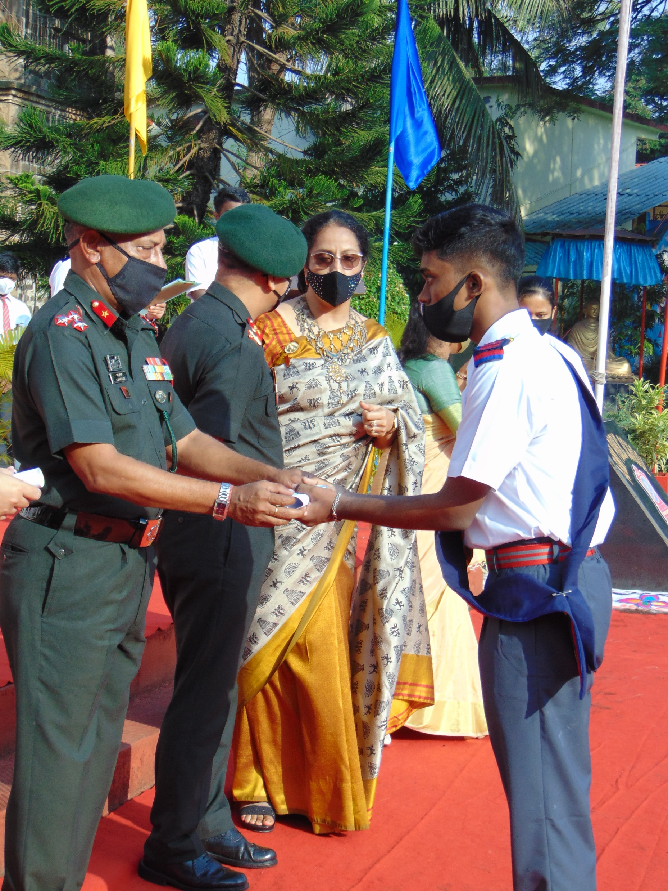
INVESTITURE CEREMONY
Patron’s address
Maj. Gen. Rakesh Manocha, SM congratulating the Head Girl
Chairman- Brig. Saumya Banerjee, SM handing over the scroll to the Office Bearer

Slide 20
GLIMPSES OF HOBBY CLUBS

Slide 21
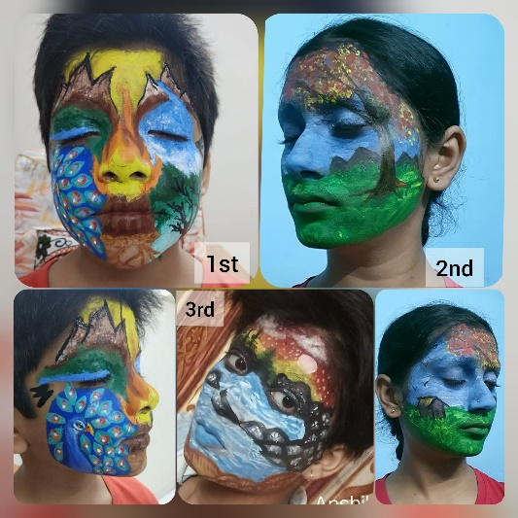
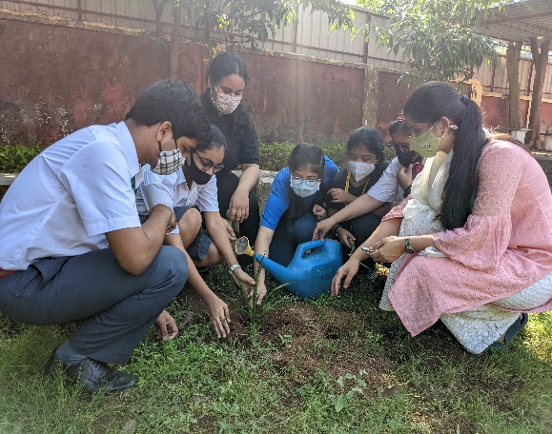
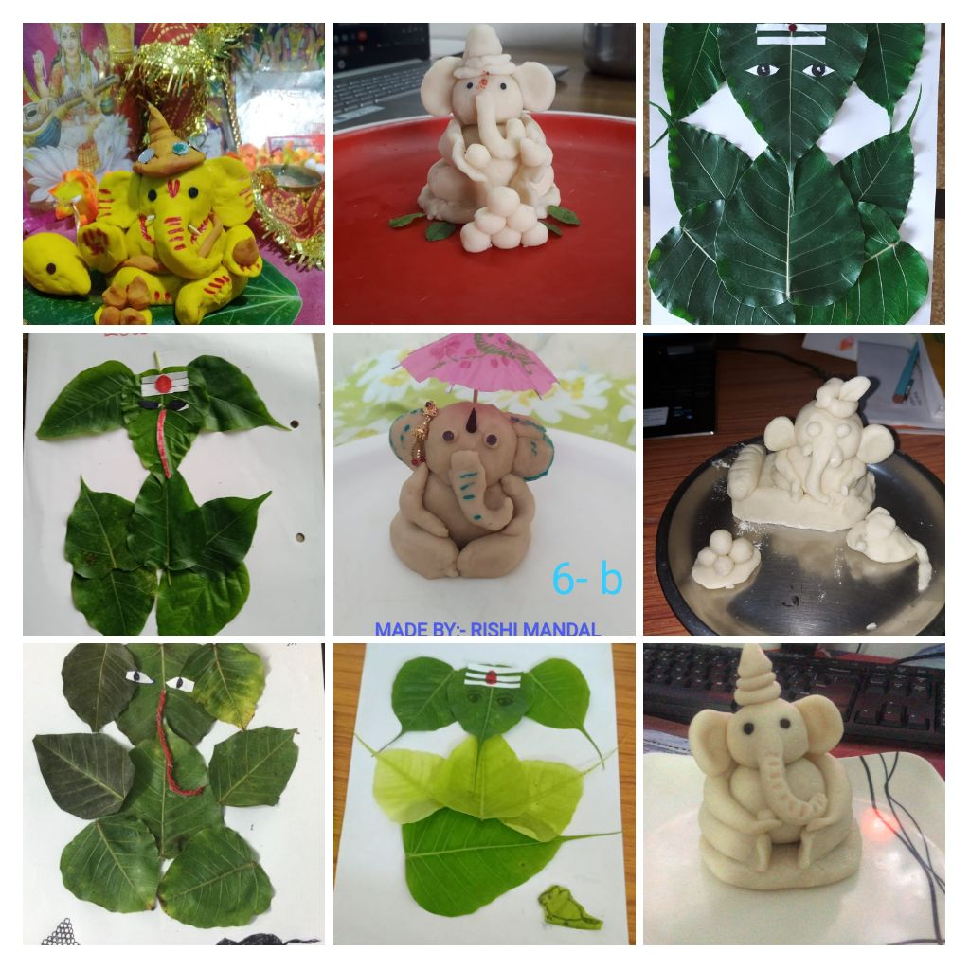
Nature club activities
Face painting Plantation drive
Ecofriendly Ganesha
MAKING

Slide 22
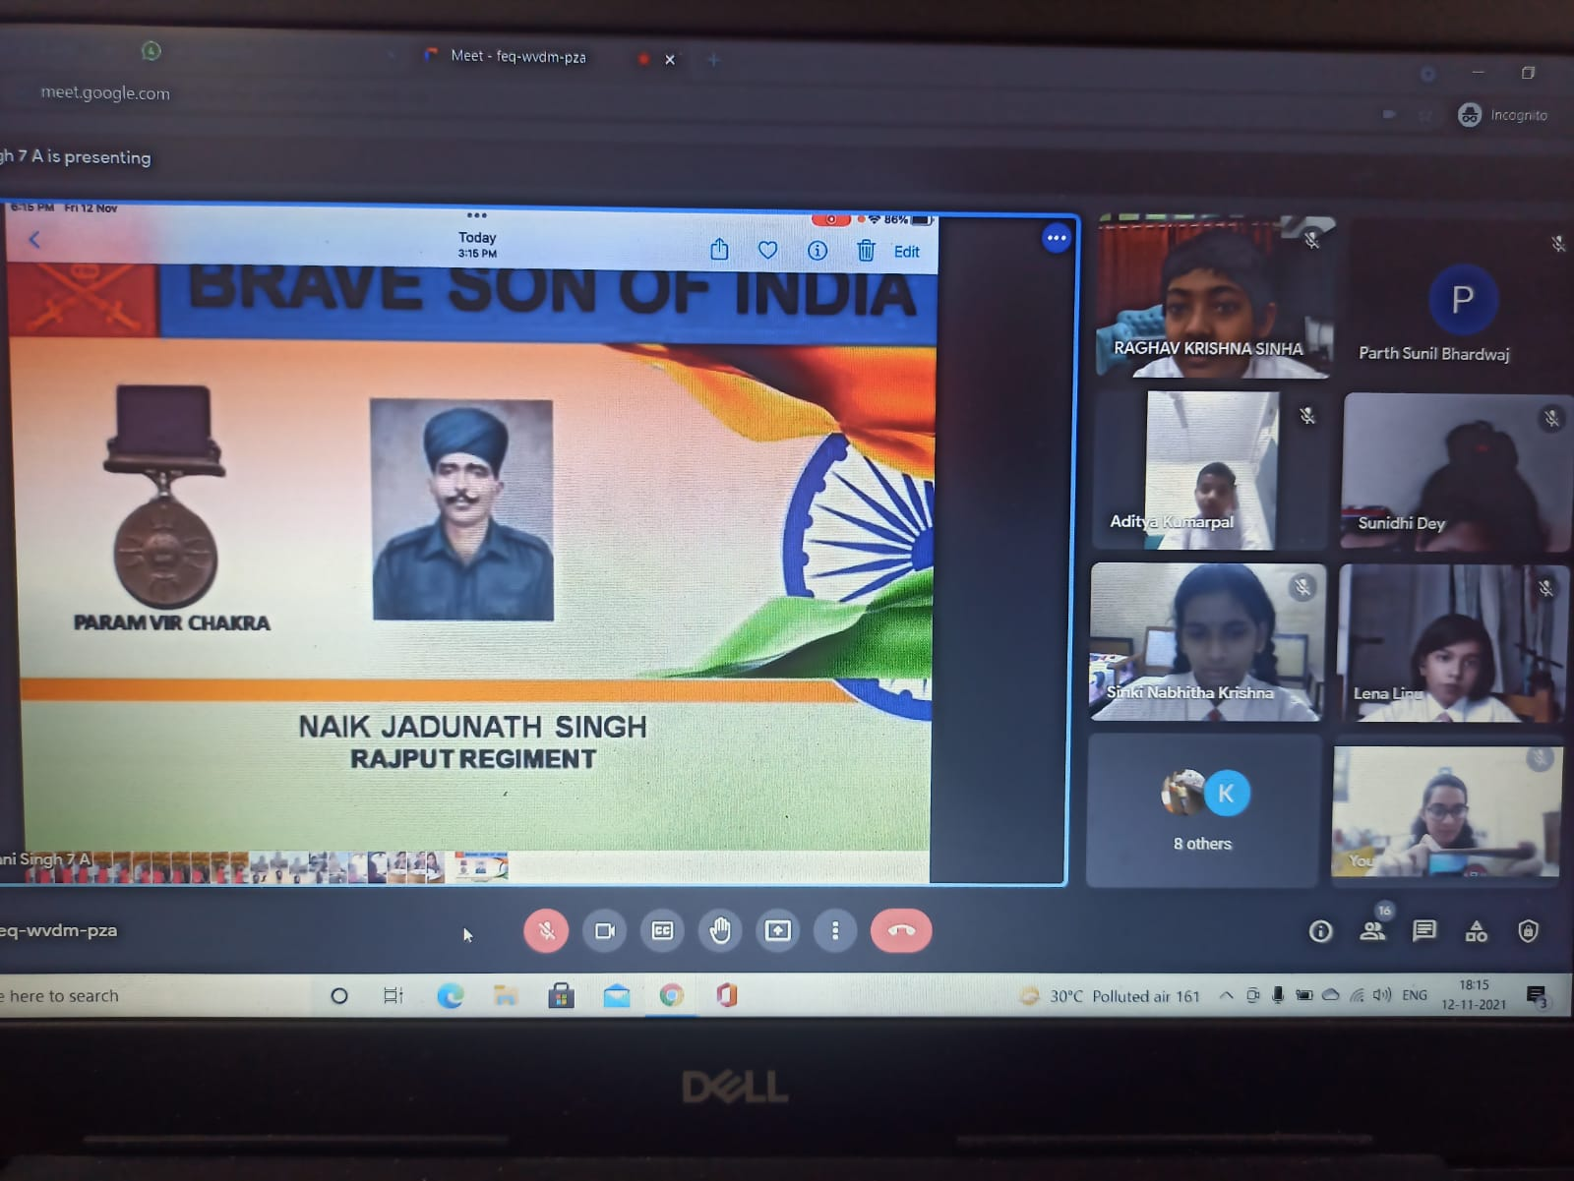
BOMBAY BOOKIES
Book review on national leaders and freedom fighters gallantry awards and their
recipients

Slide 23
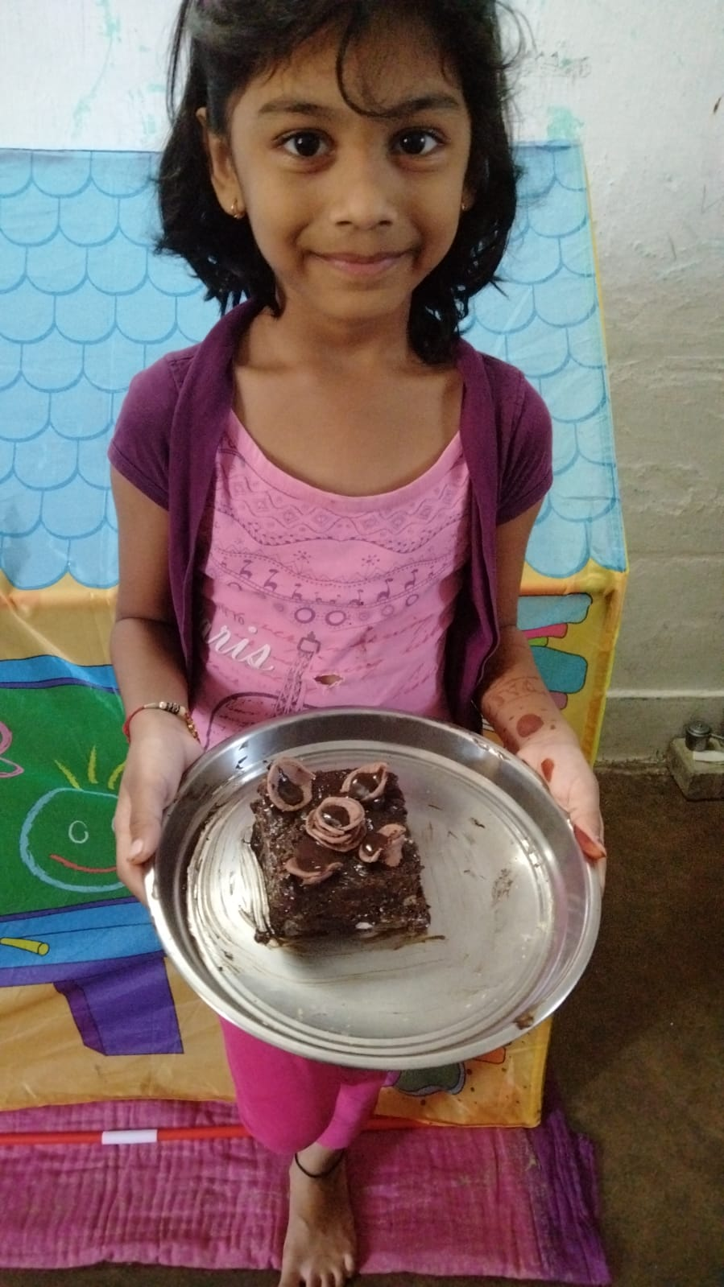
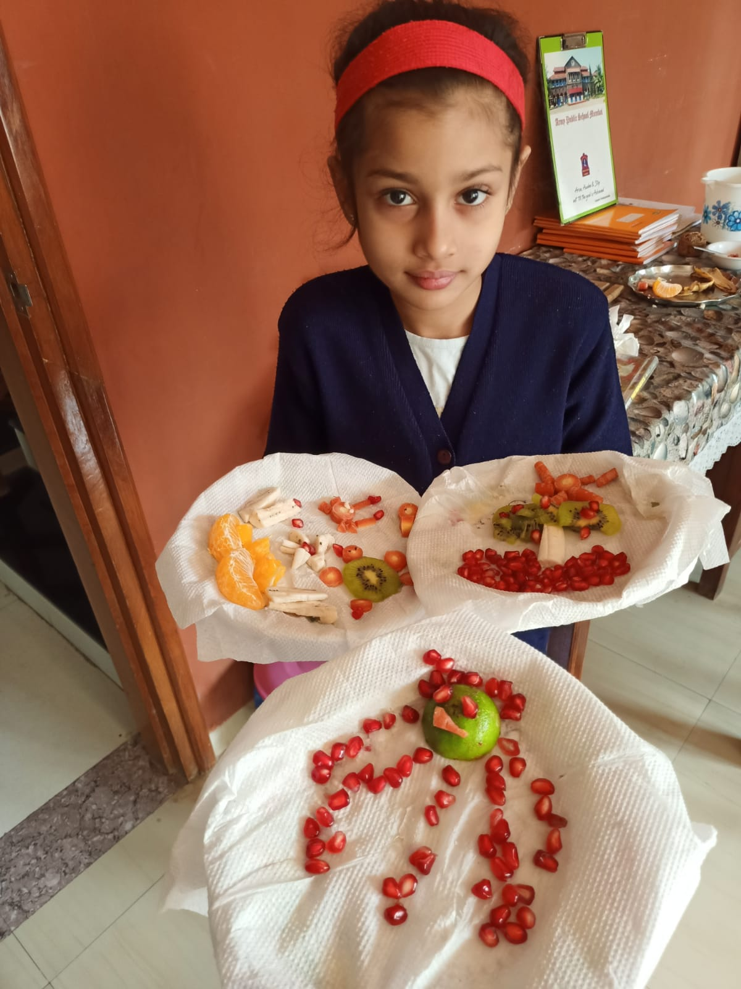
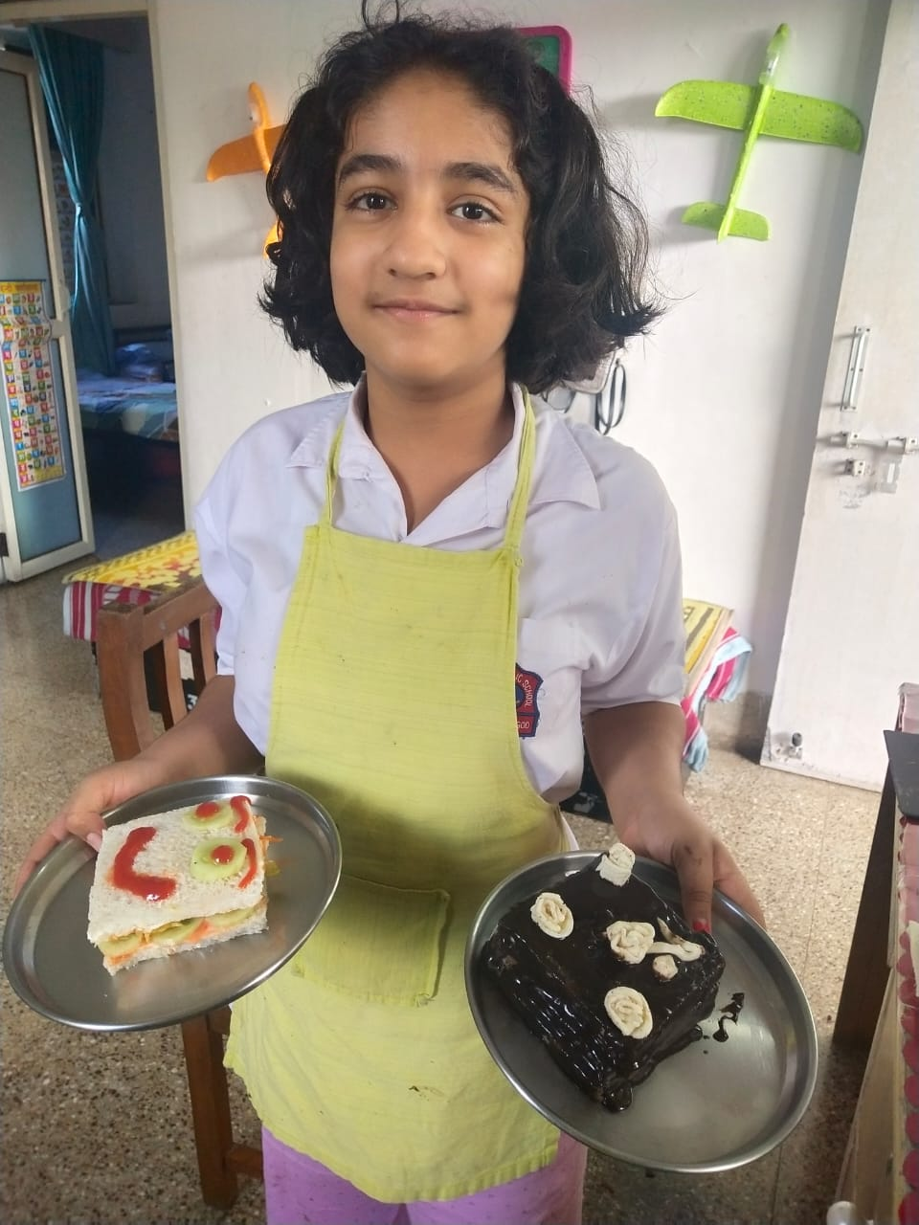
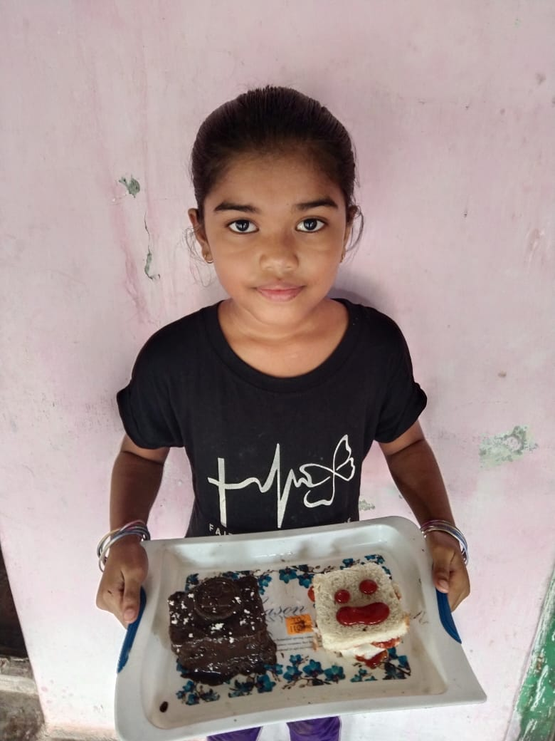
KOOL COOKS (fireless cooking)
SHUKTIJ BANERJEE- IV
SAWARA MISAL- III
ZOYA- IV
LUNASHA- V
VAISHNAVI- III

Slide 24
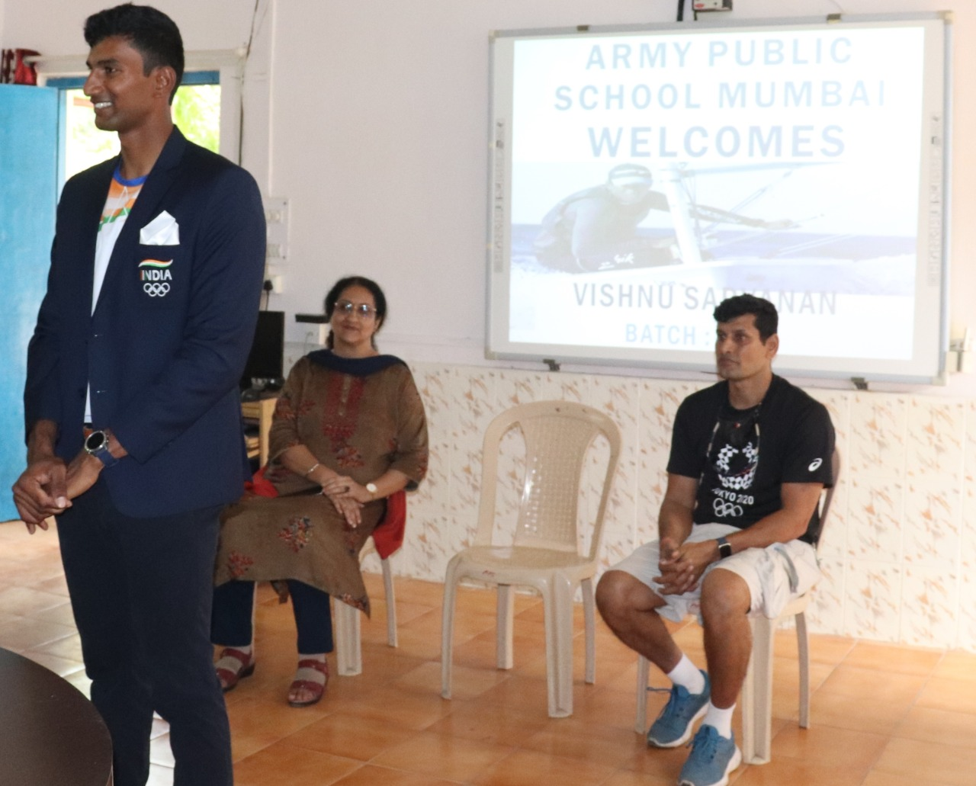
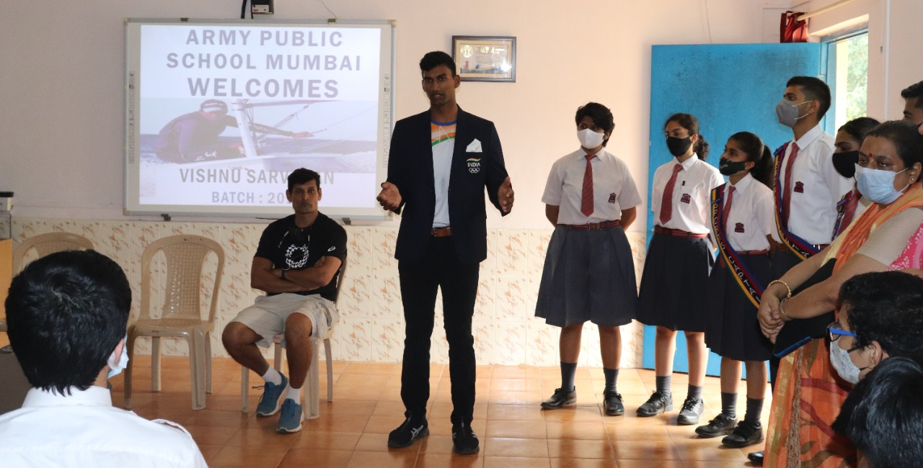
AlumnUS speaks APSM ALUMNUS, Olympian VISHNU SARVANAN INTERACTING WITH THE STUDENTS

Slide 25
A peek into recent activities

Slide 26
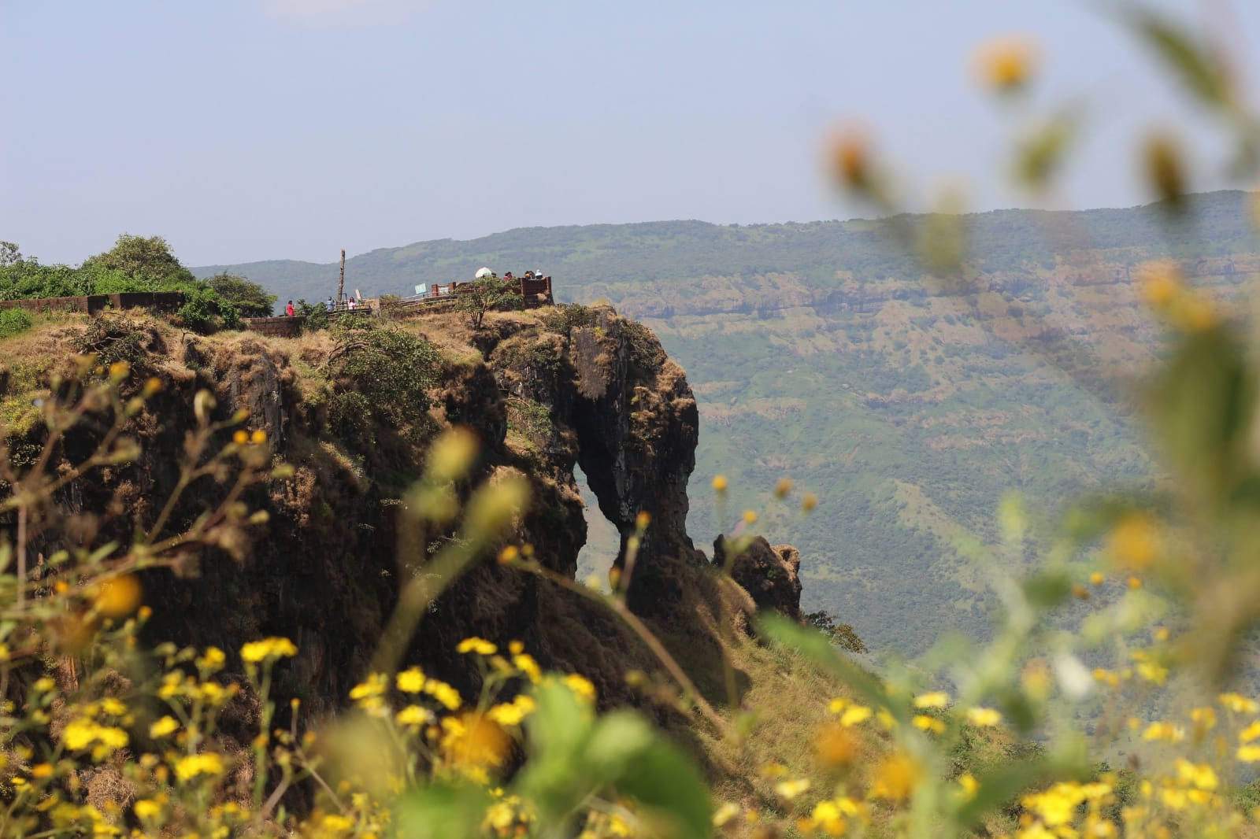
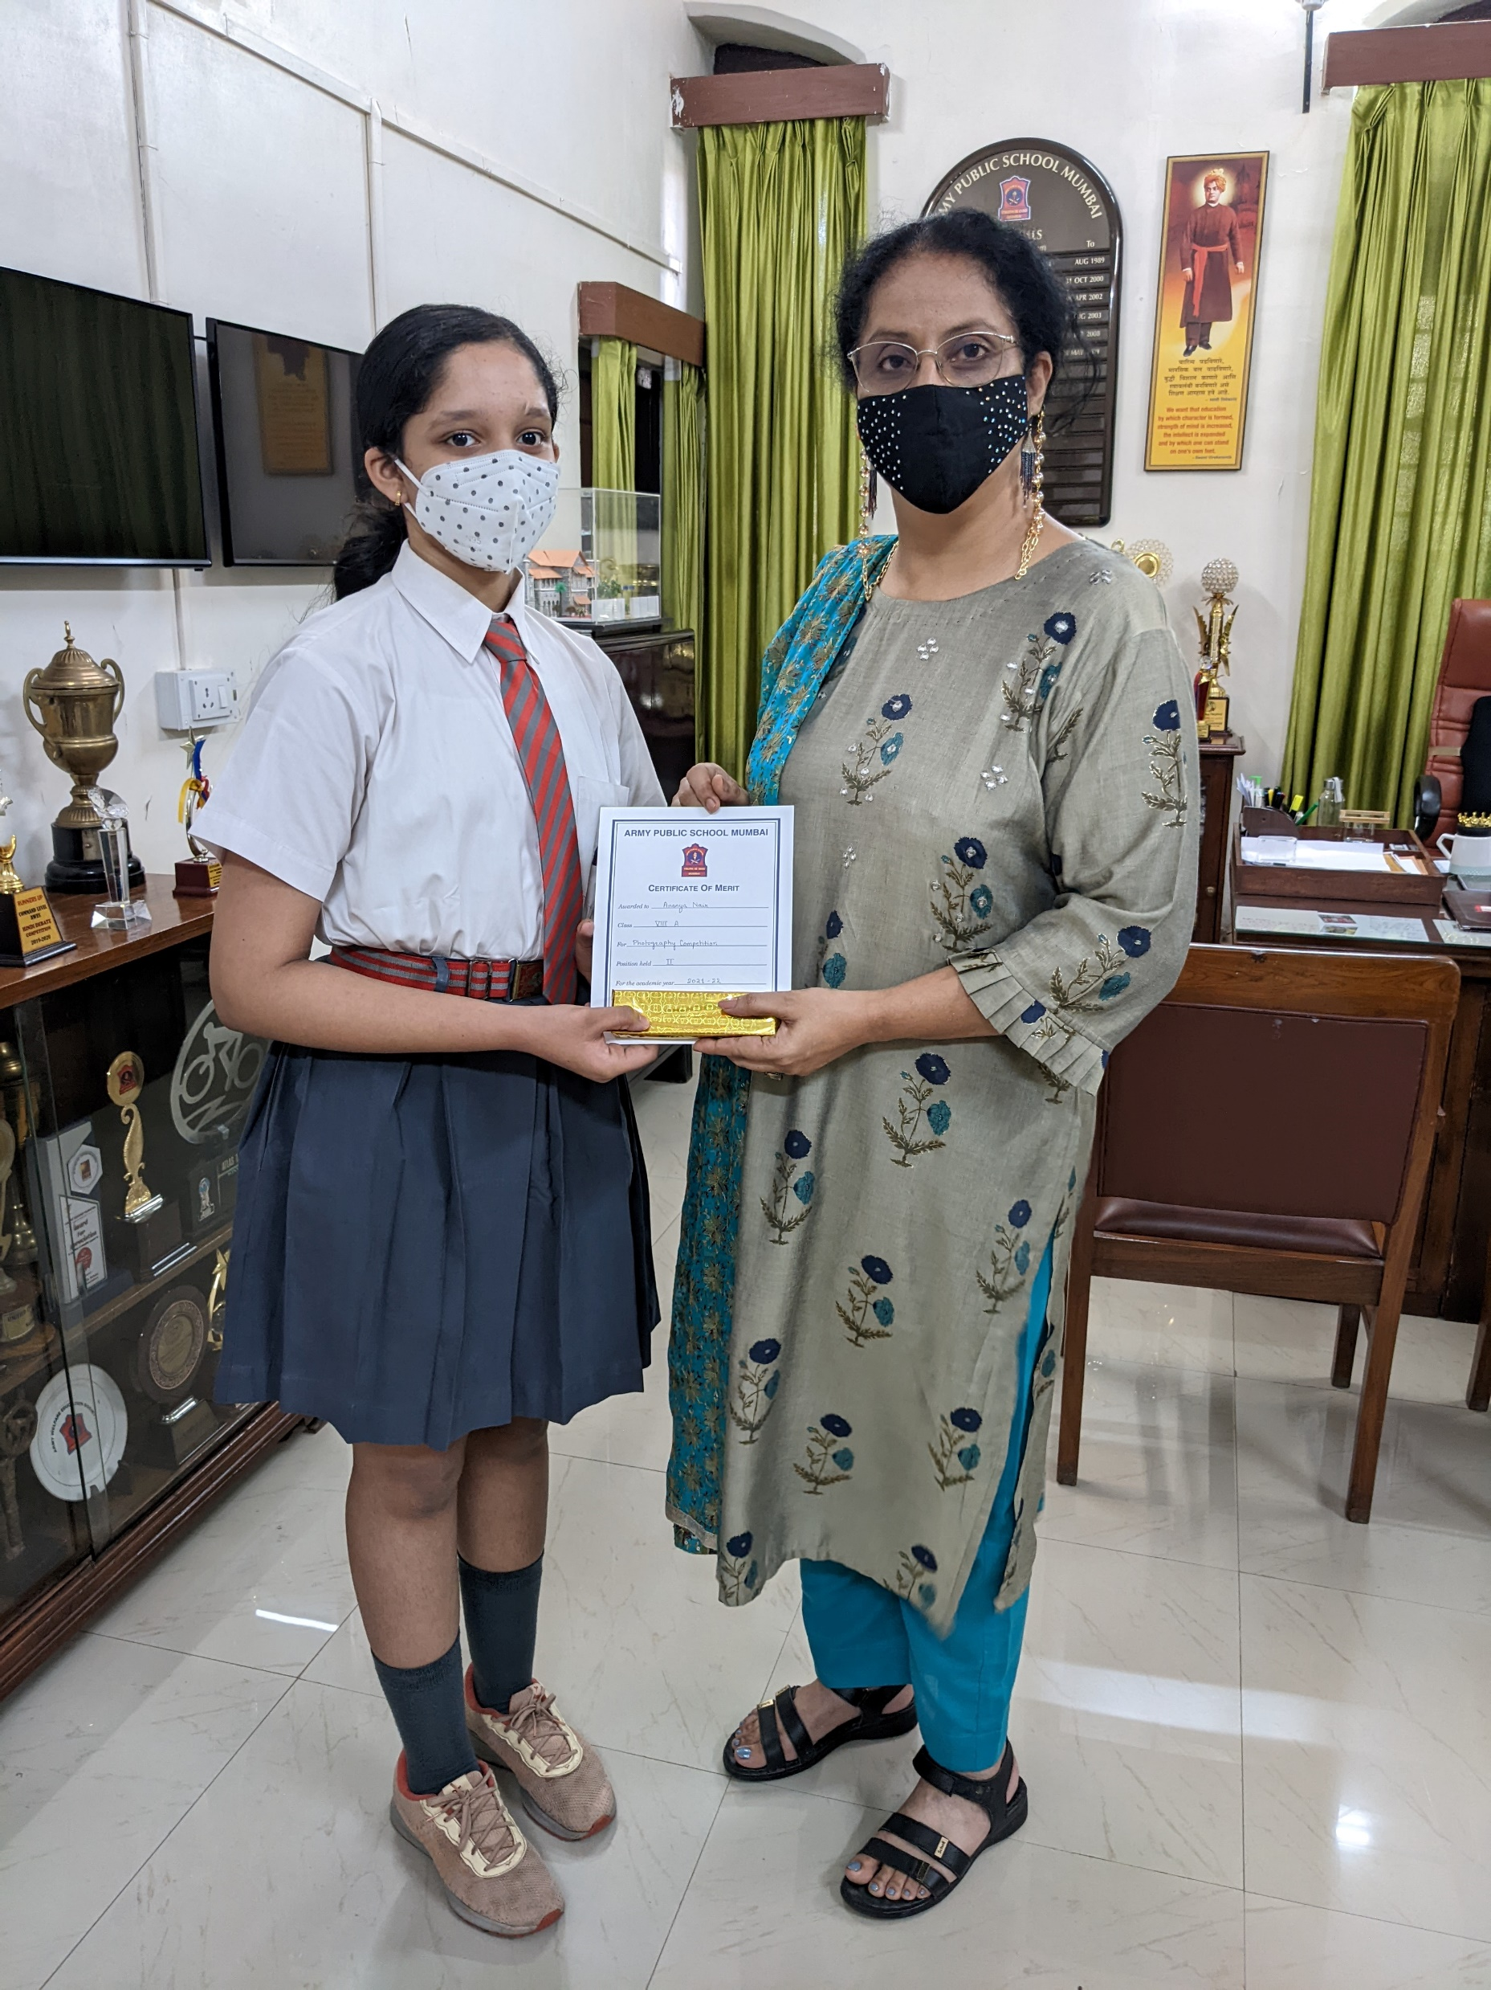
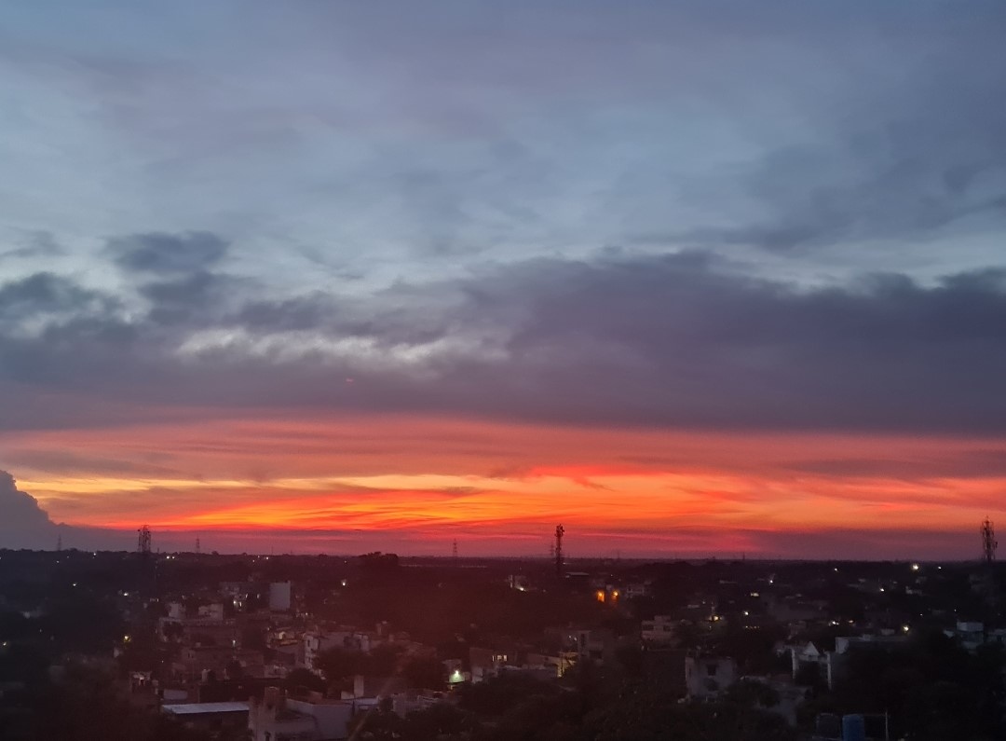
Photography competition theme ‘ Nature at its best’
HERAMB AGARWAL VIII A
TAGLINE- ‘NATURE OR ART’ IT’S ALL ABOUT PERSPECTIVE
ANANYA NAIR VIII A
TAGLINE- ‘SKY SPEAKS IN A THOUSAND COLOURS’
PRINCIPAL MRS. VIPANJOT SEHDEVA FELICITATING THE WINNER
HARSHITA SHREE VI A
TAGLINE- ‘THE GOLDEN BEGINNING'
AKANKSHA PANDEY VIII A
TAGLINE- ‘KEEP THE REALITY BEAUTIFUL BY PROTECTING NATURE’

Slide 27
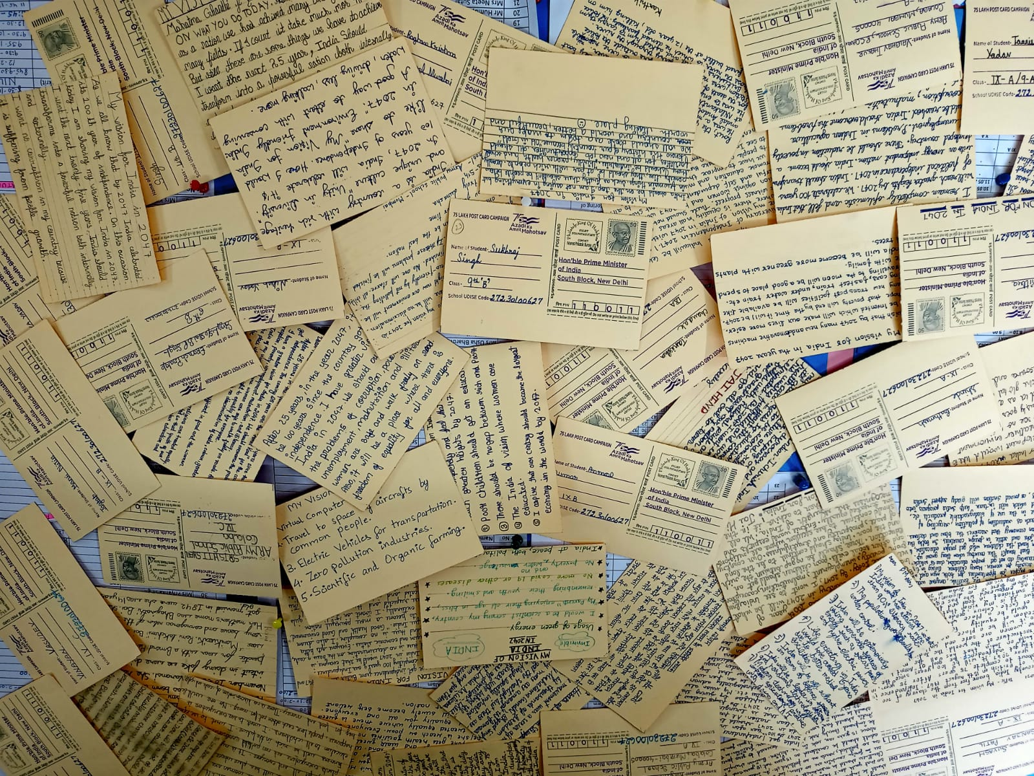
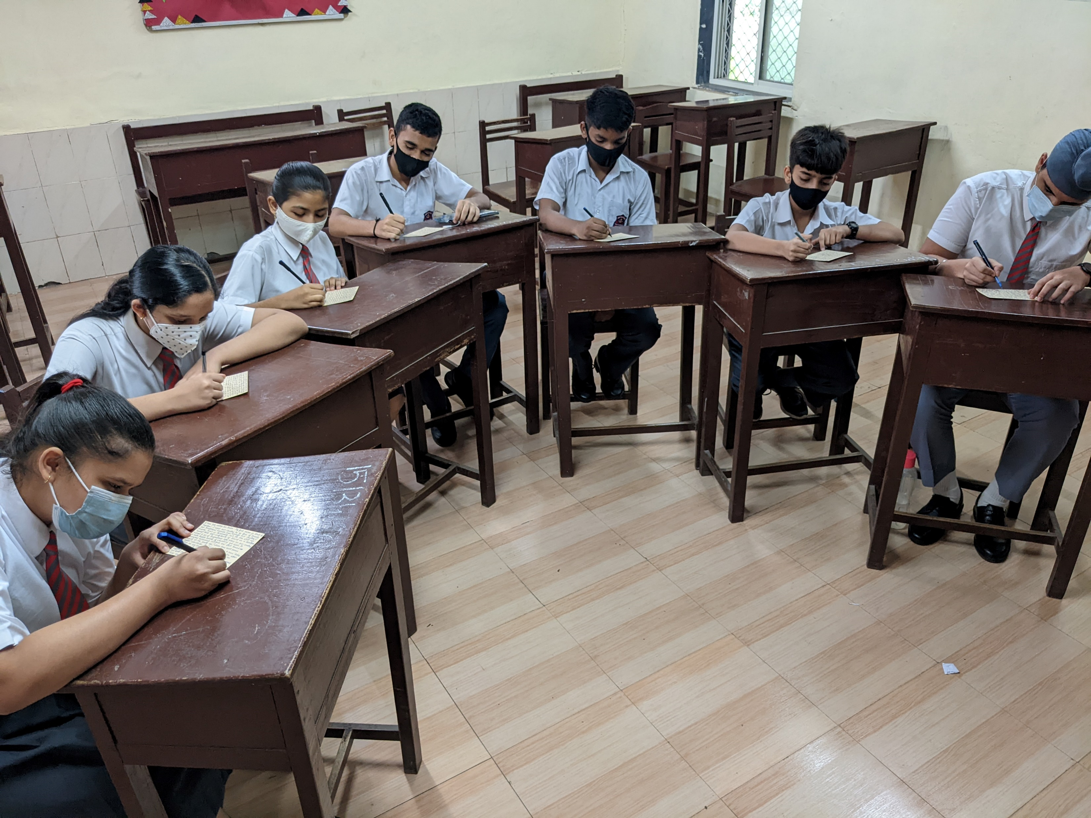
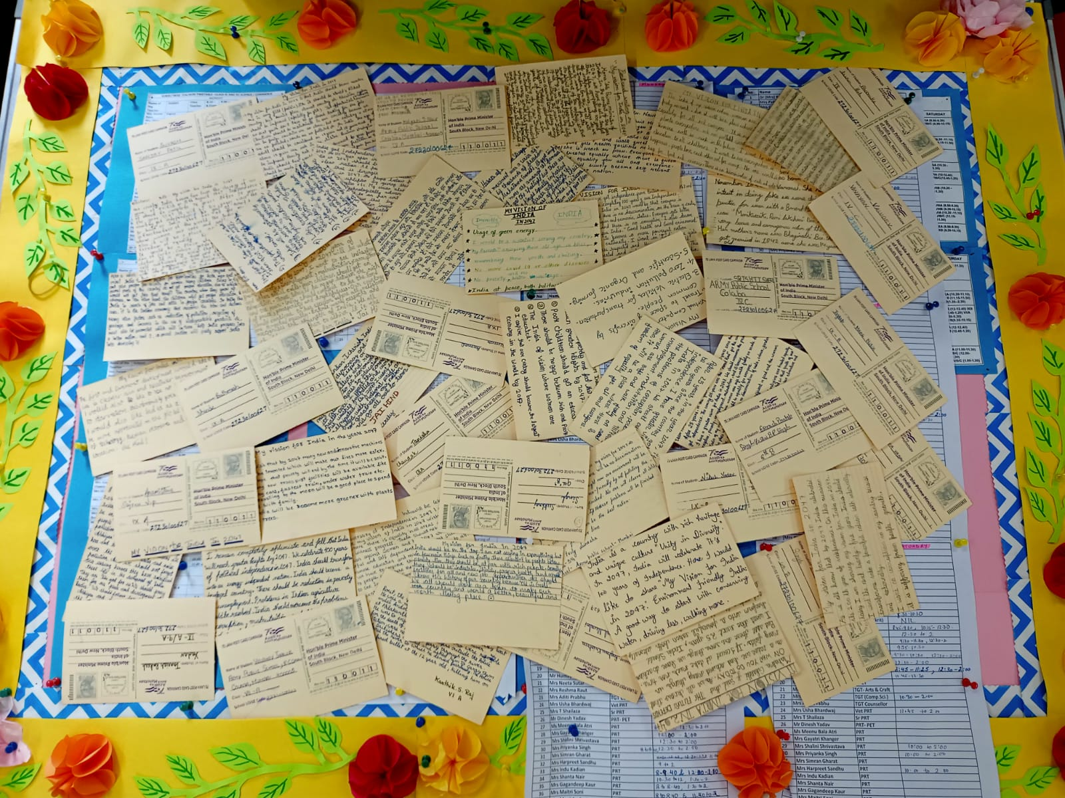
‘AZADI KA AMRUT MAHOTSAV’ 75 LAKH POSTCARD CAMPAIGN

Slide 28
THANK YOU

